Slide 1
FORAGING
Vishal Kannan Parthiban Saravanakumar

Slide 2
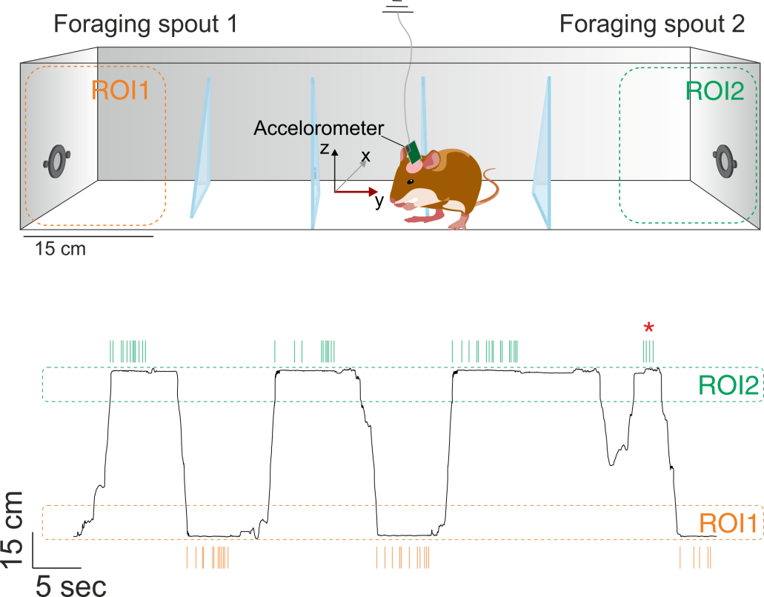
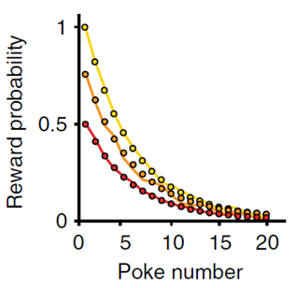
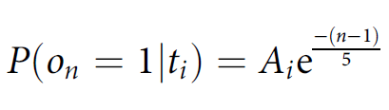
Behaviour Paradigm
Each food restricted animal was trained for 25 days (sessions) continuously in the foraging paradigm without any breaks
Lottem et al., 2018

Slide 3
The trials, rewards and pokes
Last poke
Unrewarded
Pokes
Trials with starting reward probability = 1
Trials with starting reward probability = 0.75
Rewarded
Trials
Trials with starting reward probability = 0.5
First poke
Unrewarded pokes
Unrewarded
Note: Coloured pokes are rewarded
Lottem et al., 2018

Slide 4
Events, consequence, and decisions
Last poke
Unrewarded
What make the last poke the last?
Exploitation to exploration shift
(last rewarded poke to last poke)
Pokes
Overall cortical dynamics – frontal activity
Trials
Rewarded
Cortical layer dynamics
First poke
Unrewarded

Slide 5
The trials, rewards and pokes
Last poke
Unrewarded
Pokes
Last rewarded poke
Trials with starting reward probability = 1
Trials with starting reward probability = 0.75
Rewarded
Trials
Trials with starting reward probability = 0.5
First poke
Unrewarded pokes
Unrewarded
Note: Coloured pokes are rewarded
Lottem et al., 2018

Slide 6

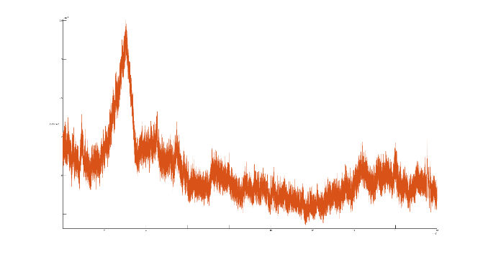
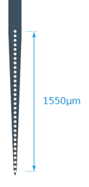
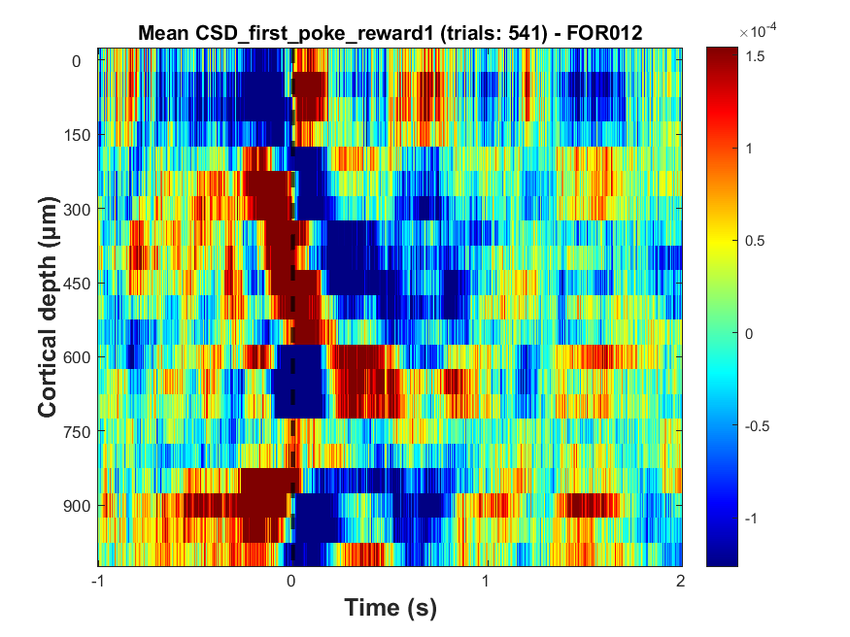
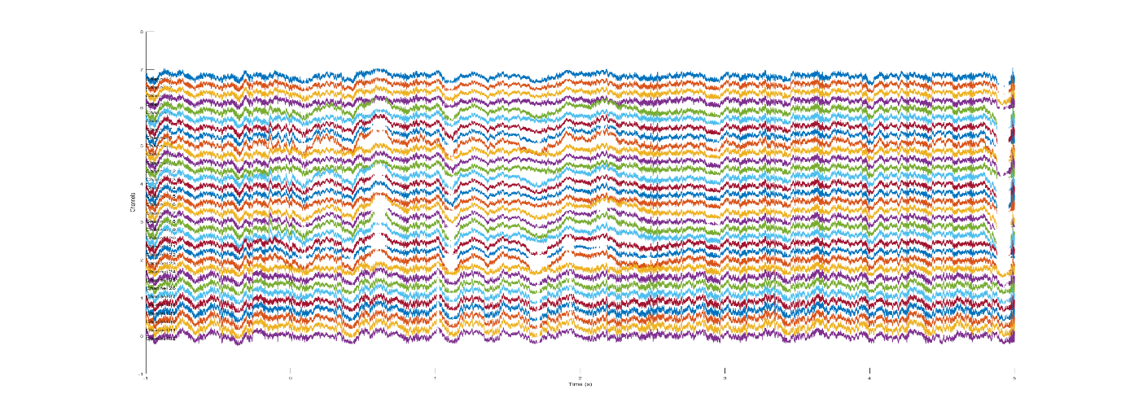
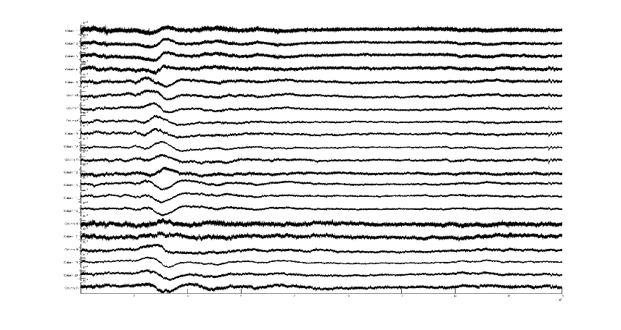
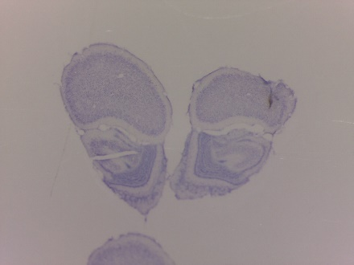
PROCESSING
Second spatial derivative
Layers
I/II/III
Bregma: 4.65mm; ML: 1mm
IV
Va
Vb
VI
Local field potentials
(LFPs)
sink
source
AVREC
Nissl Staining
Current Source Density
(CSD)
Budinger et al., 2016; Zempeltzi et al., 2020

Slide 7
Behaviour data plot
Relatively constant travel time to indicate that the animal showed learnt behaviour from Session 5:20

Slide 8
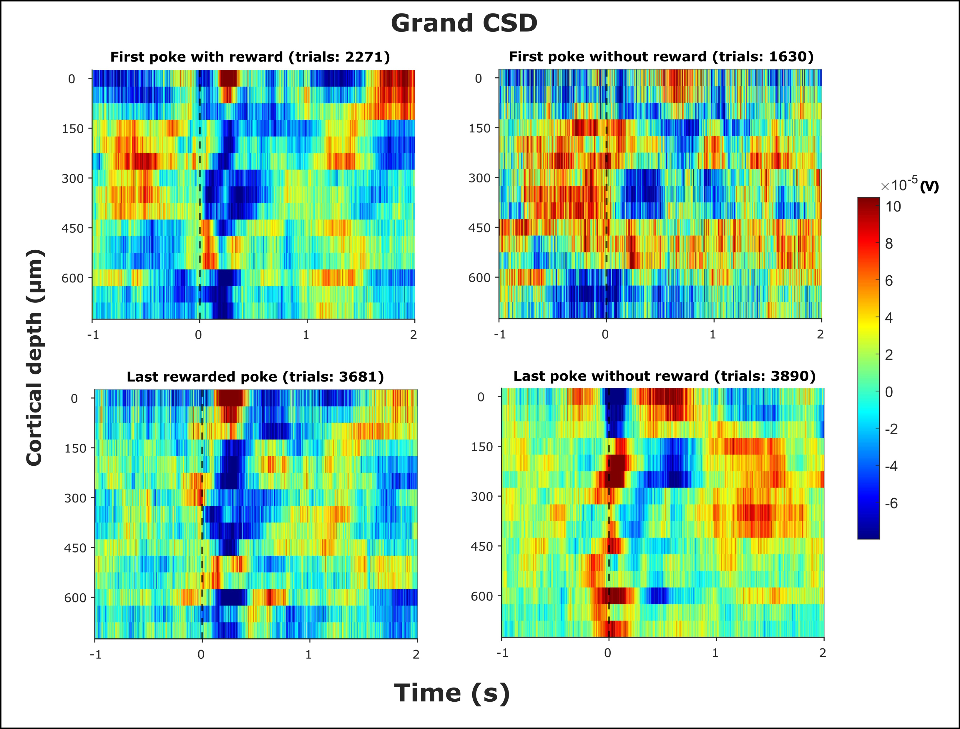
Grand CSD

Slide 9
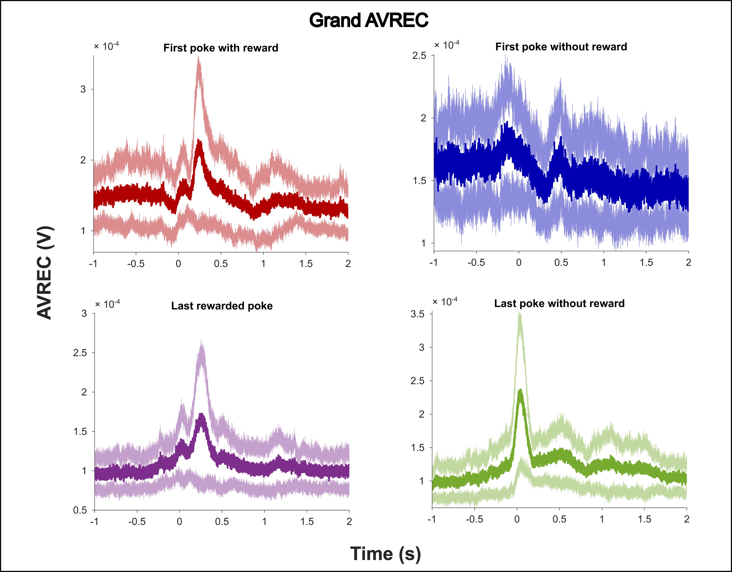
Grand AVREC

Slide 10
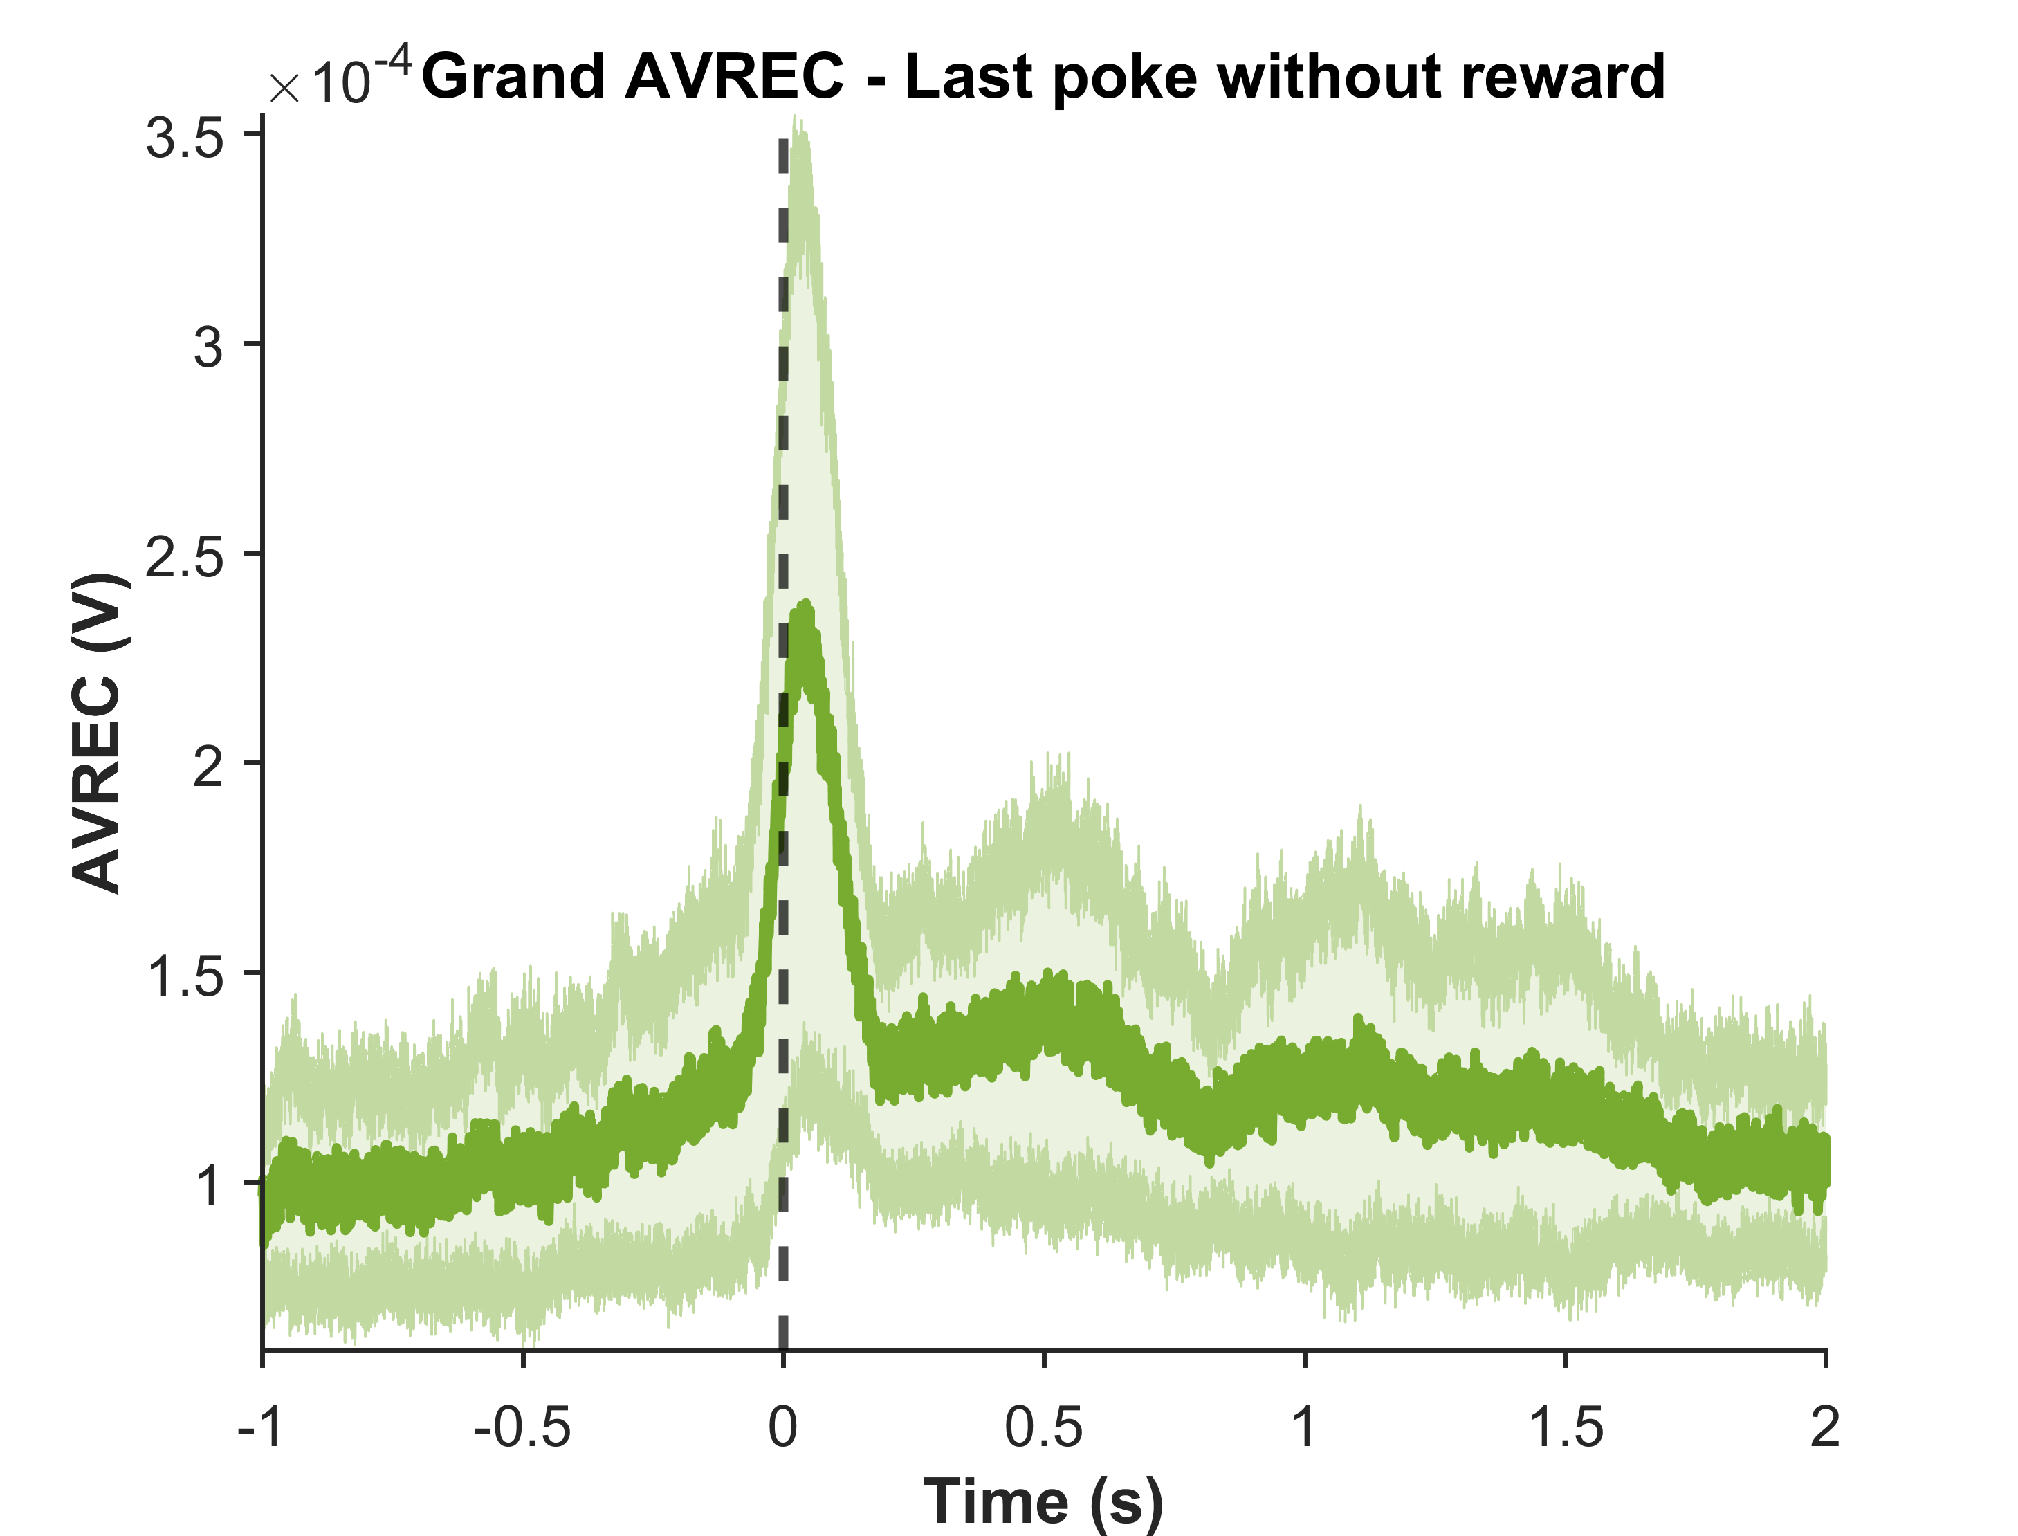
Grand AVREC
Before poke phase
Early phase
Late phase

Slide 11
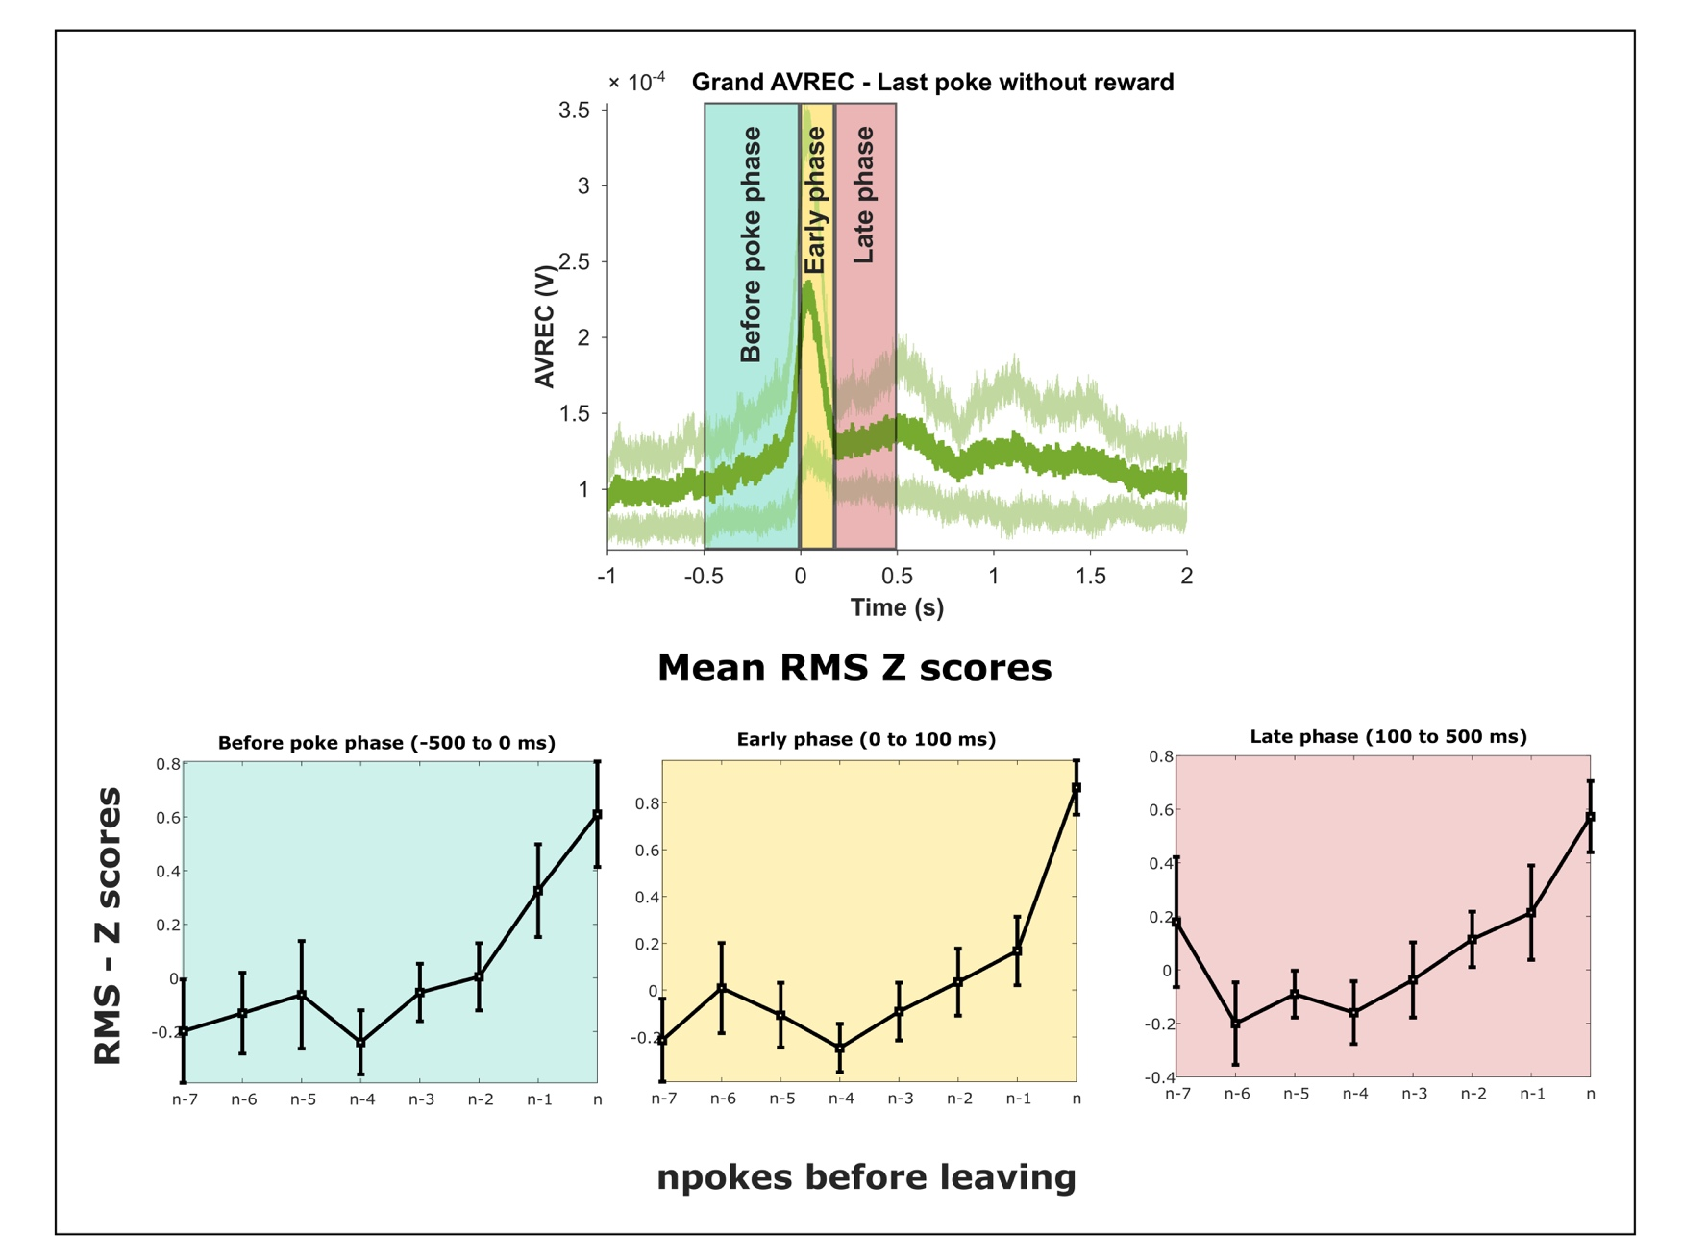
RMS analysis - Last rewarded poke to last poke

Slide 12
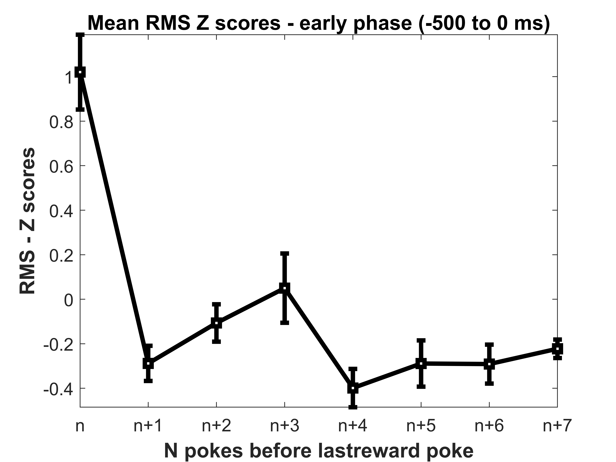
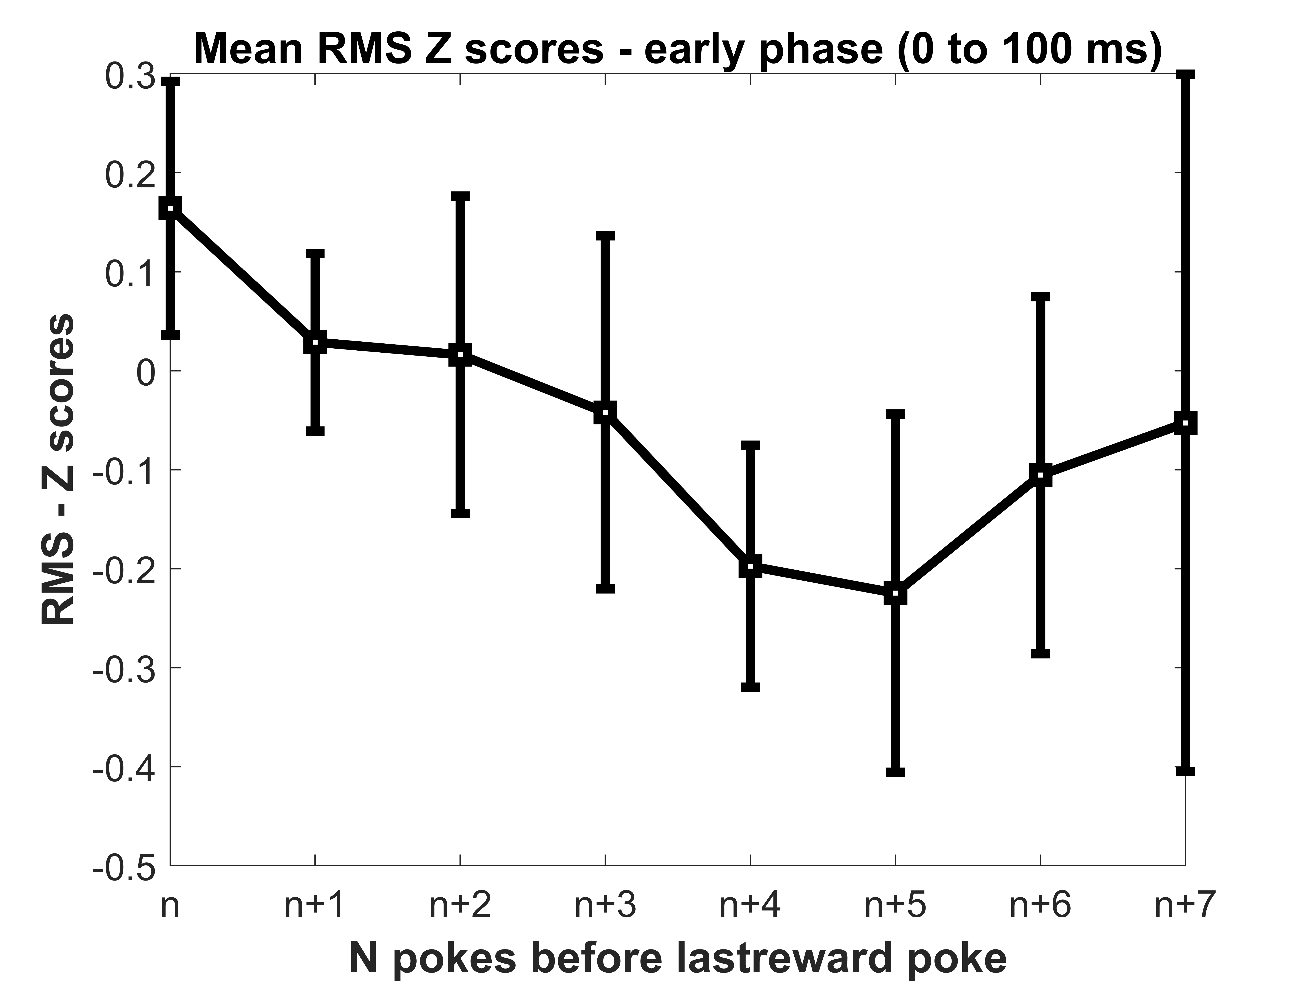
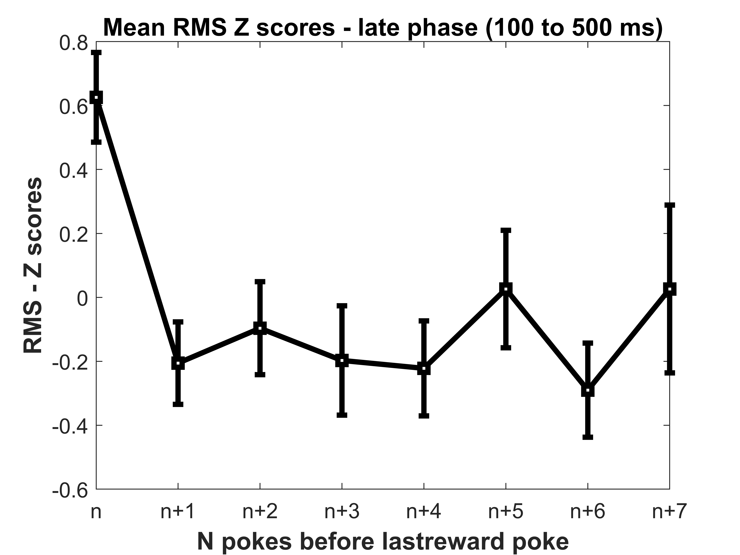
RMS analysis – First poke to last rewarded poke

Slide 13
Layer Analysis

Slide 14
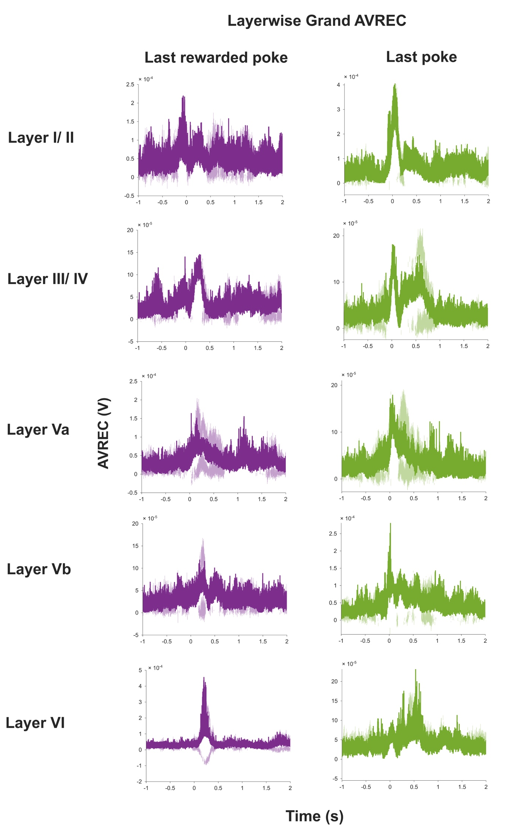
Grand layer wise average - Rectified sinks

Slide 15
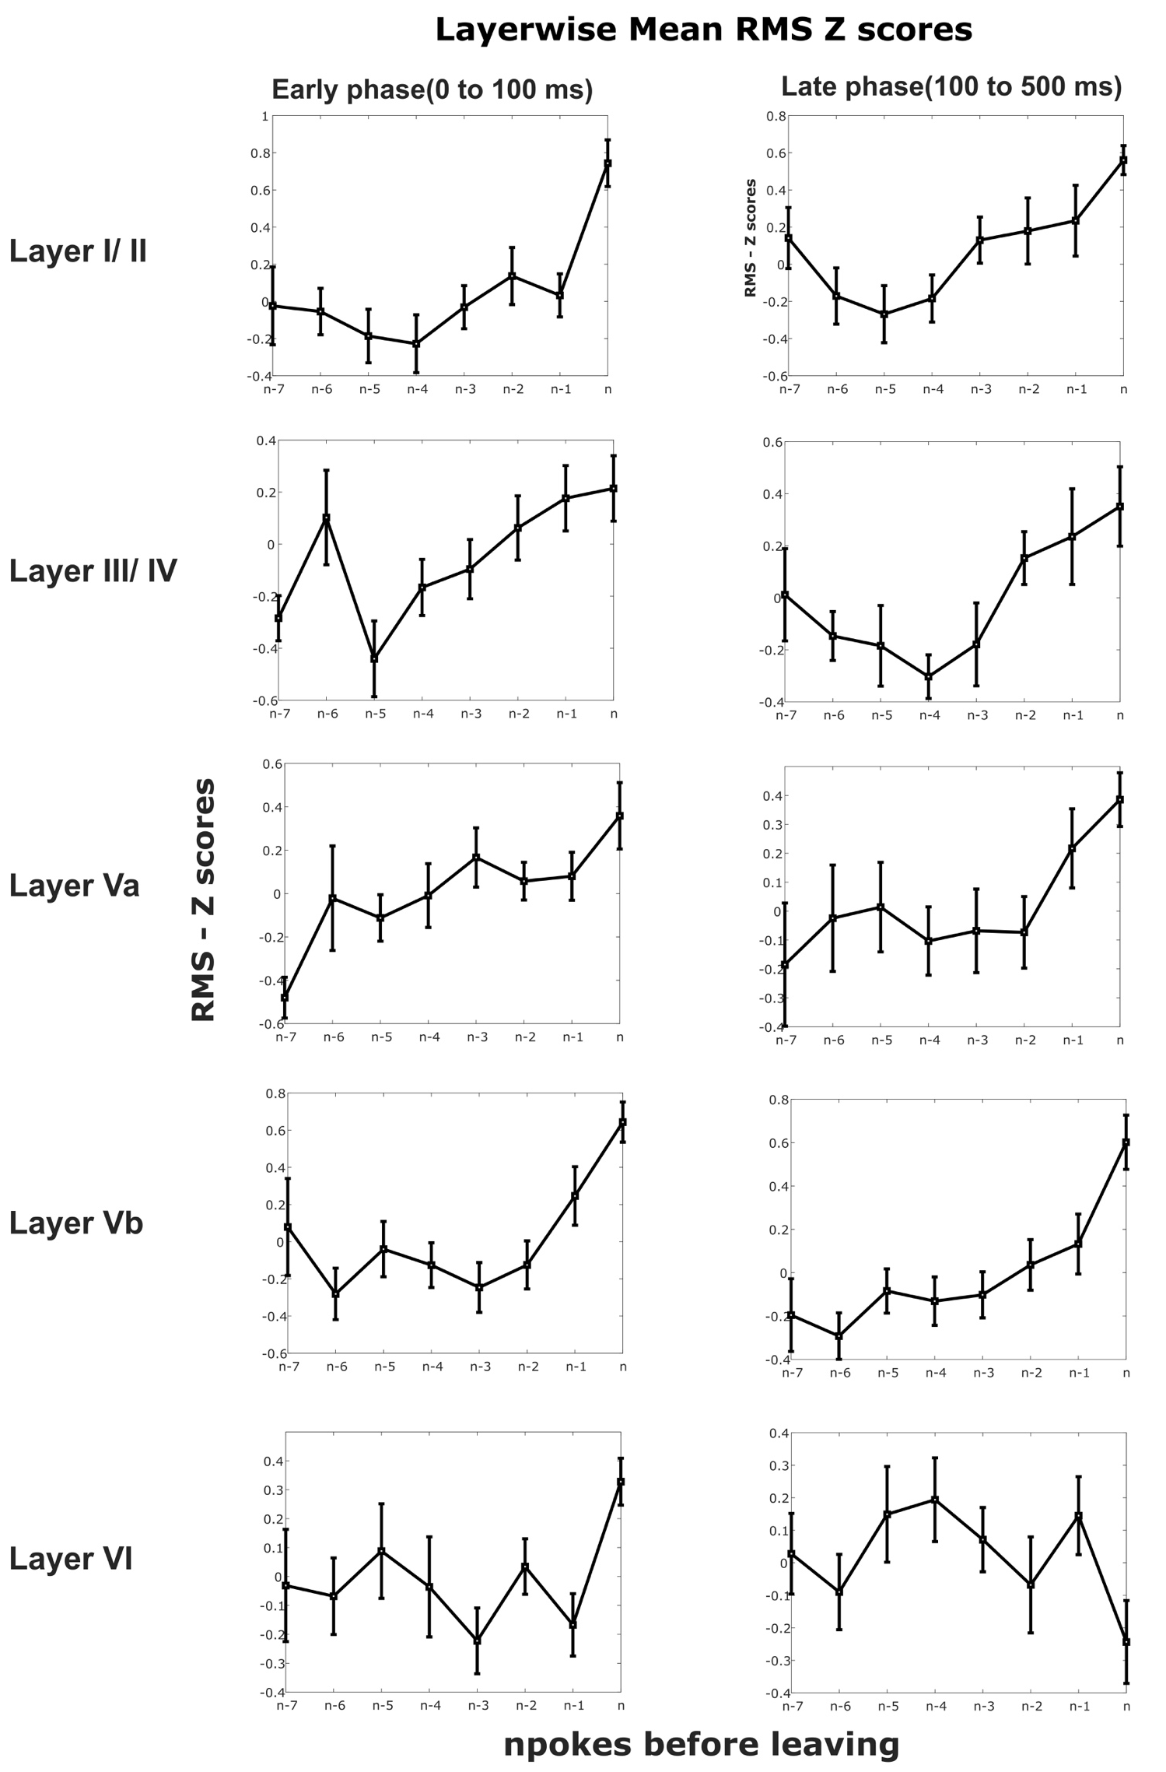
Grand layer wise RMS of rectified sinks last reward to last poke

Slide 16
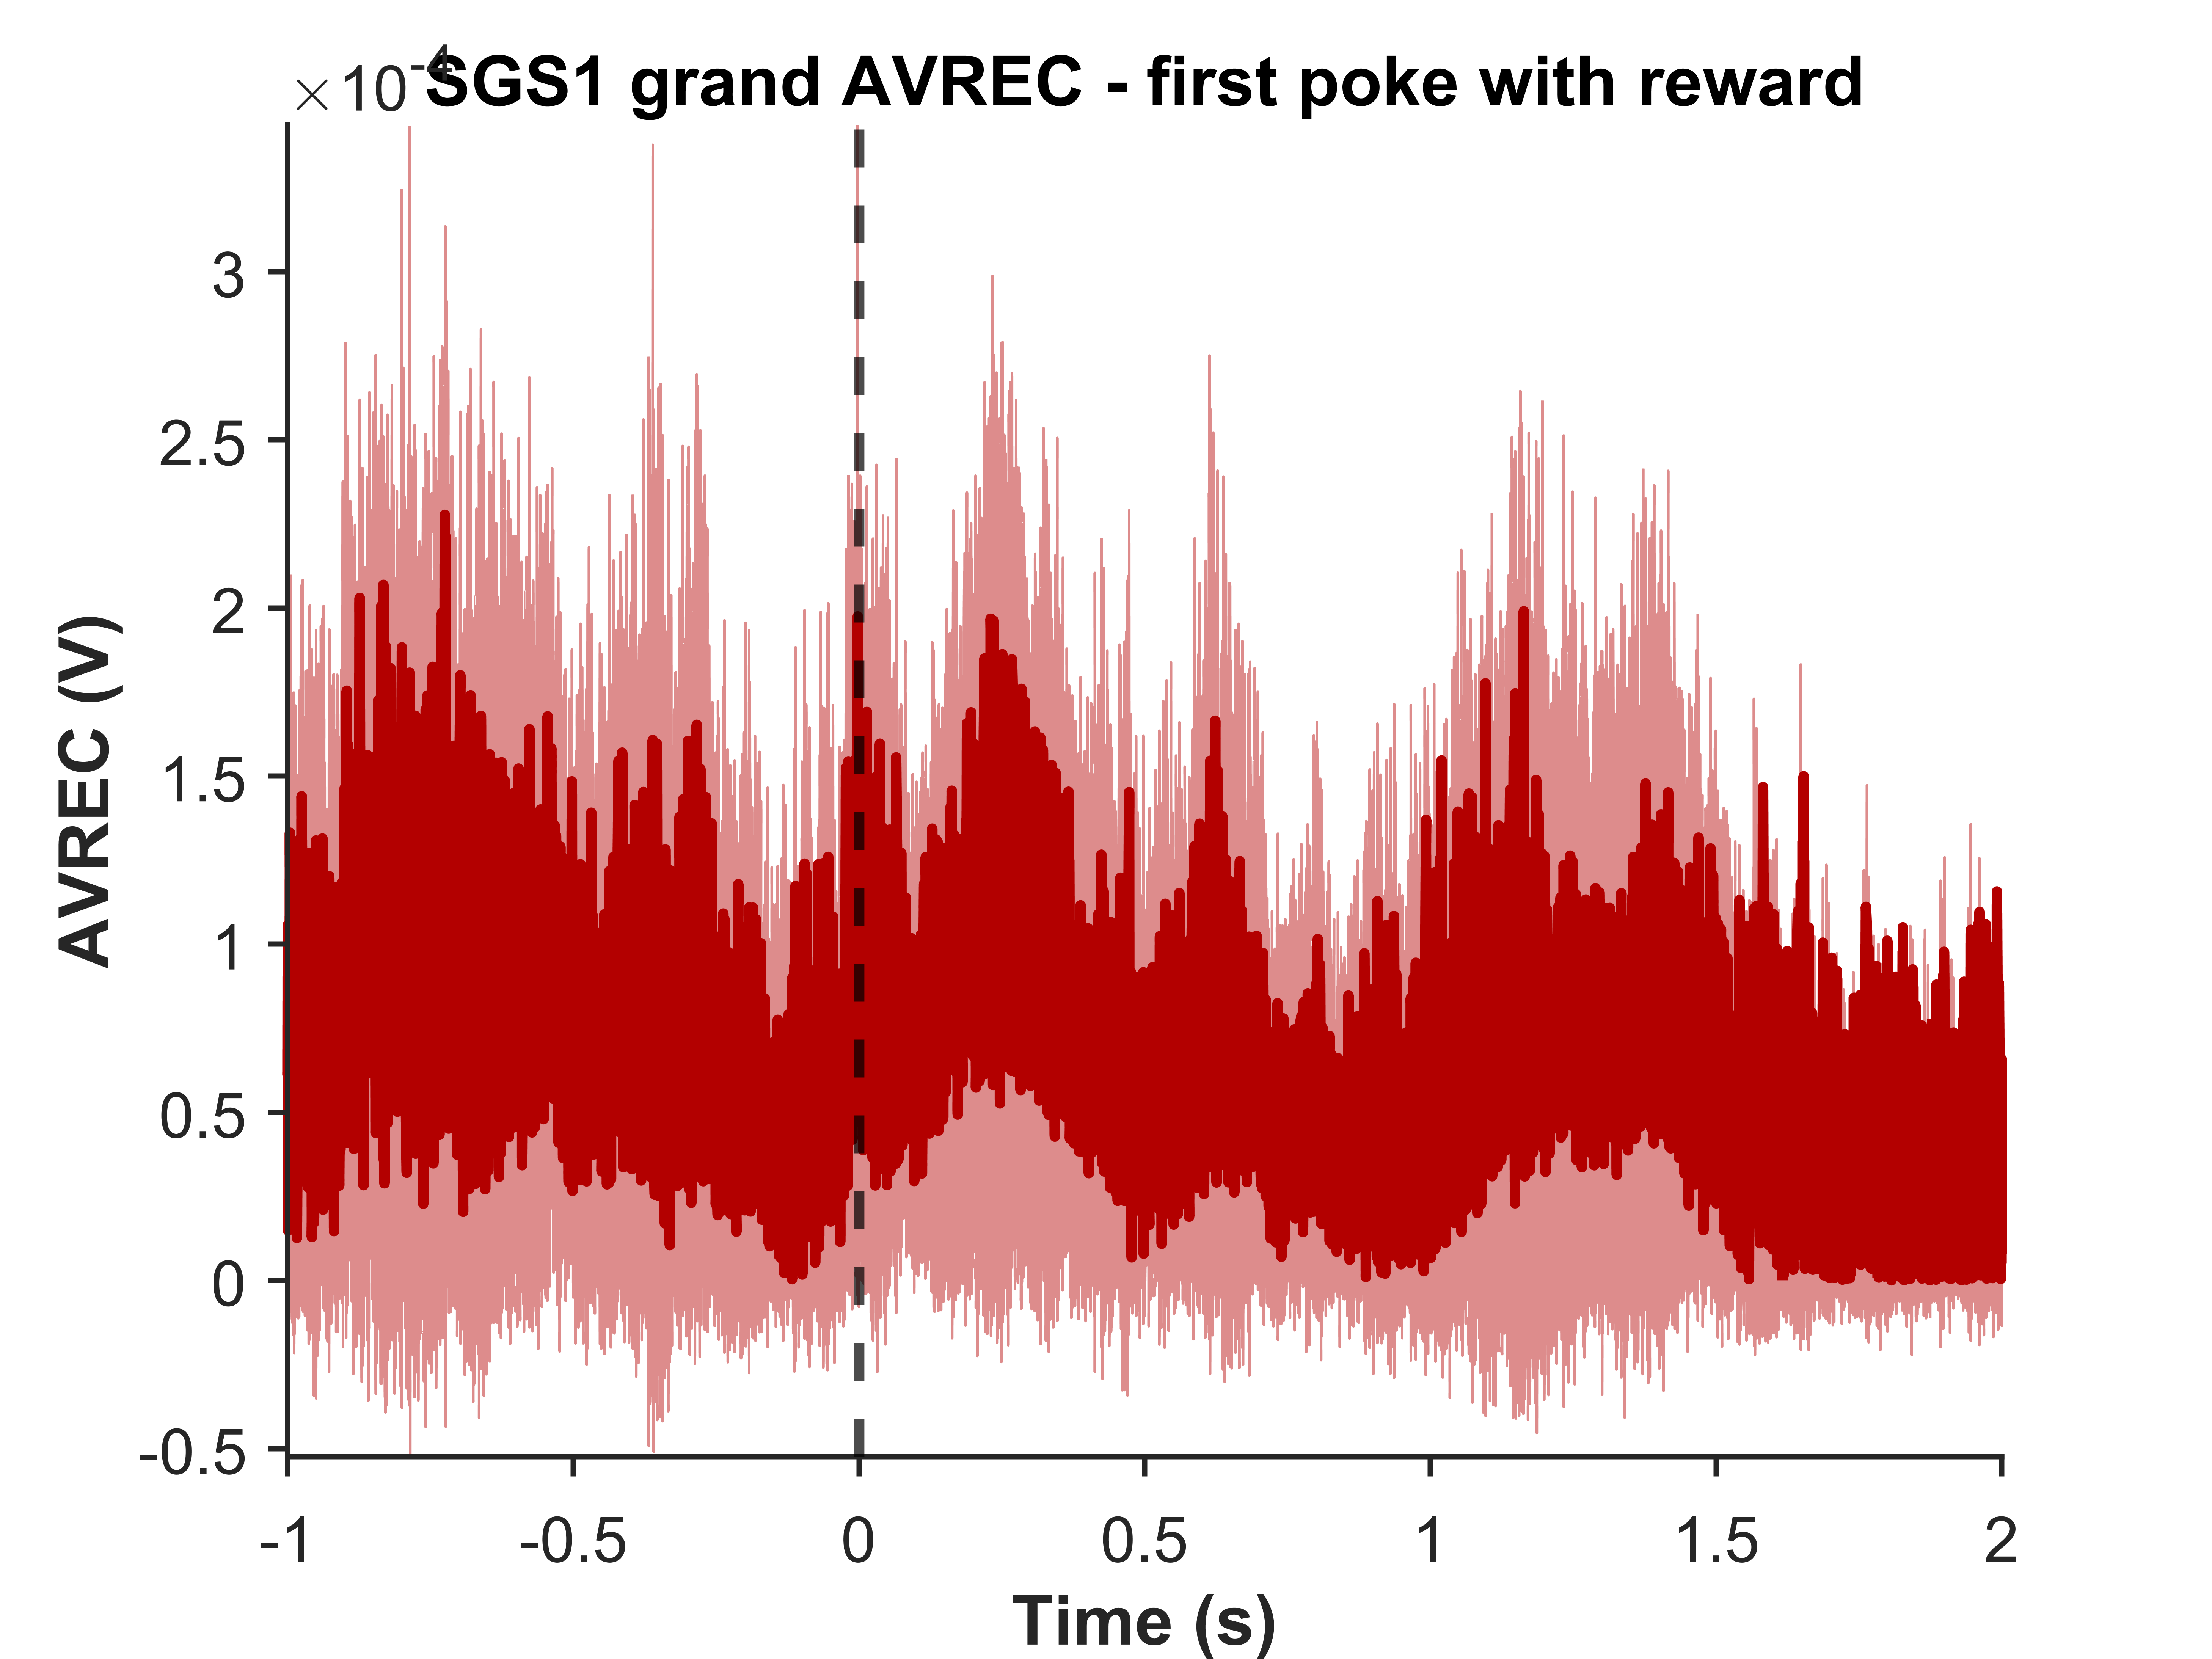
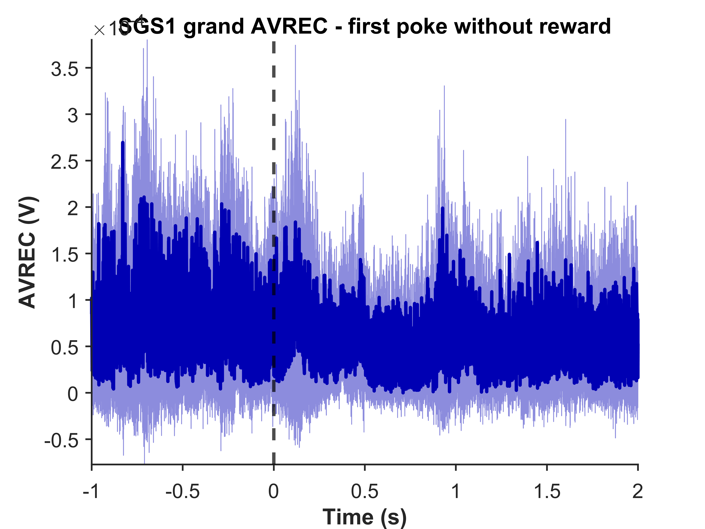
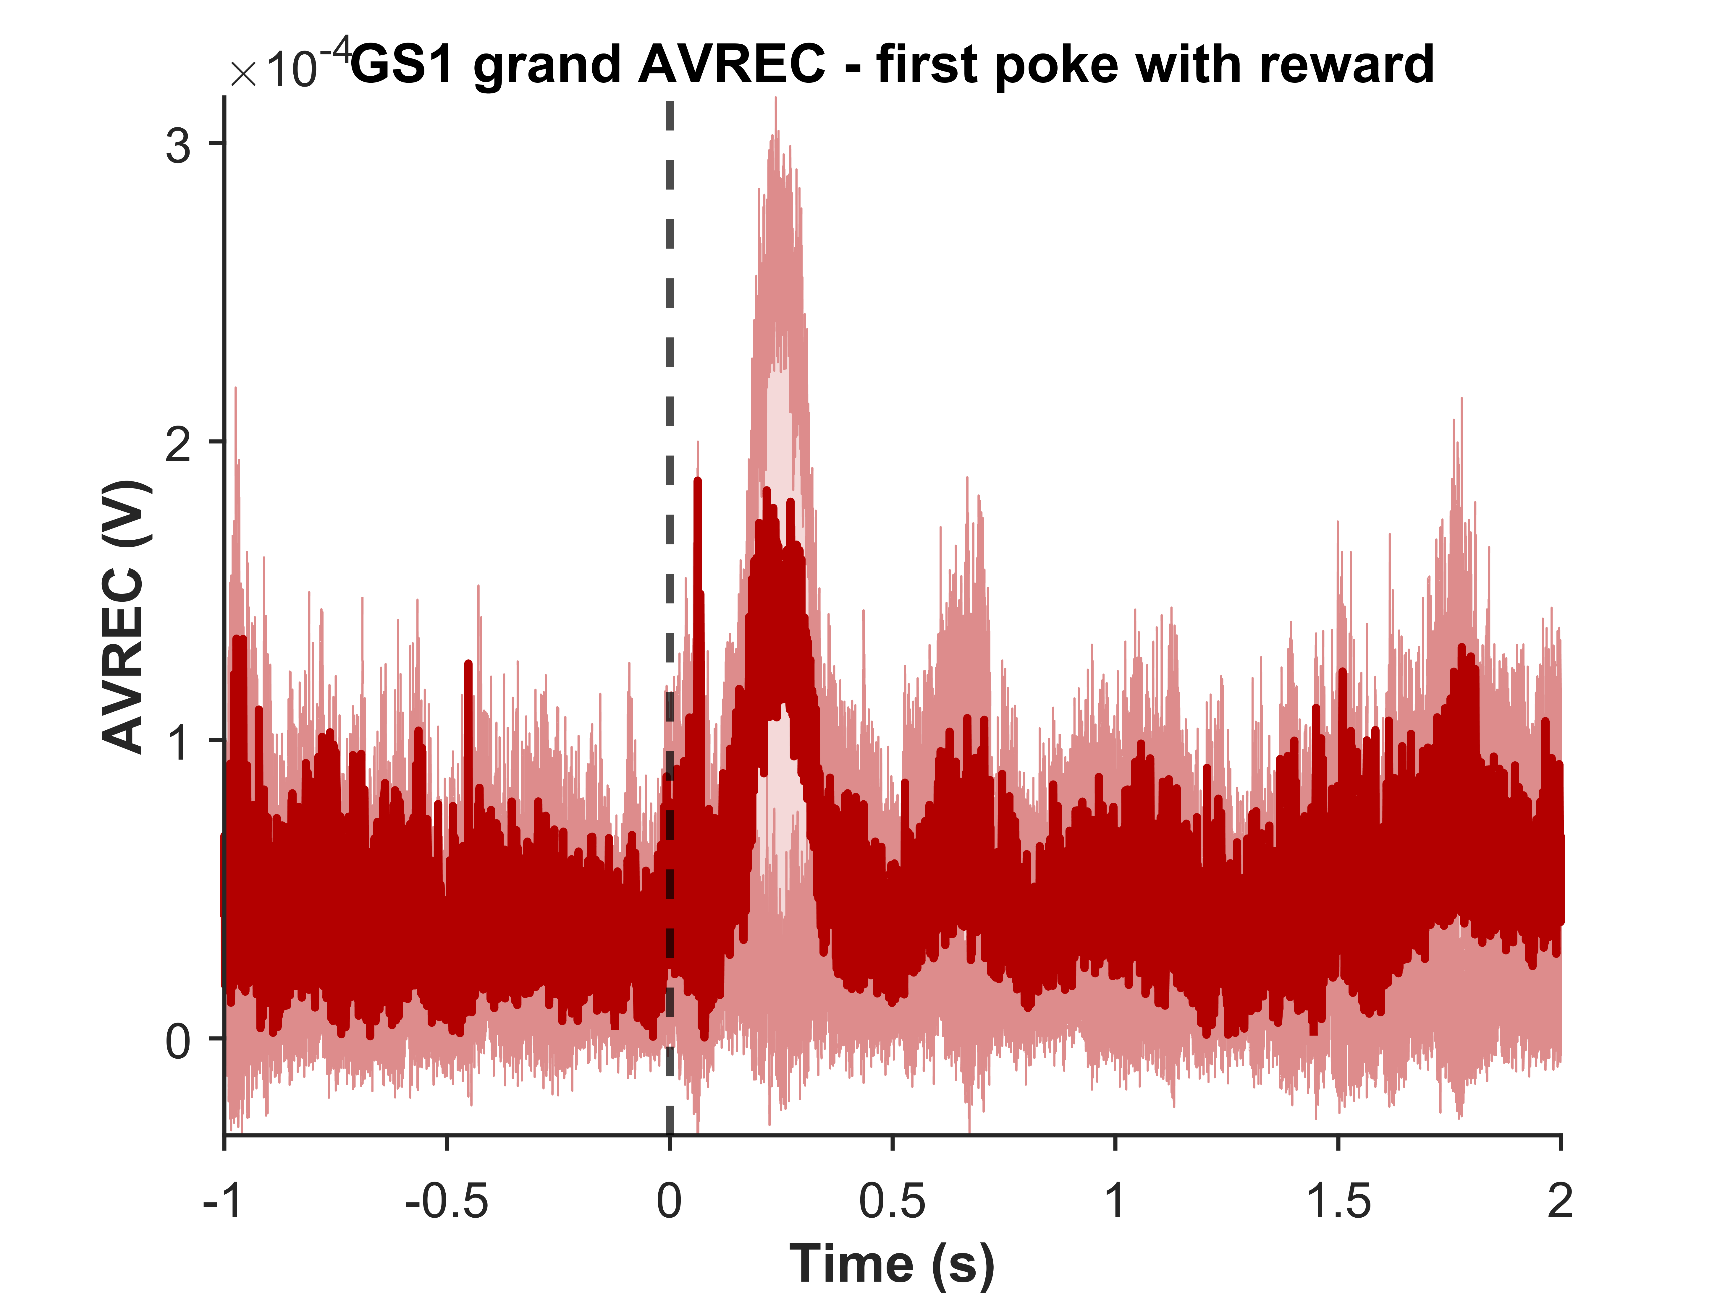
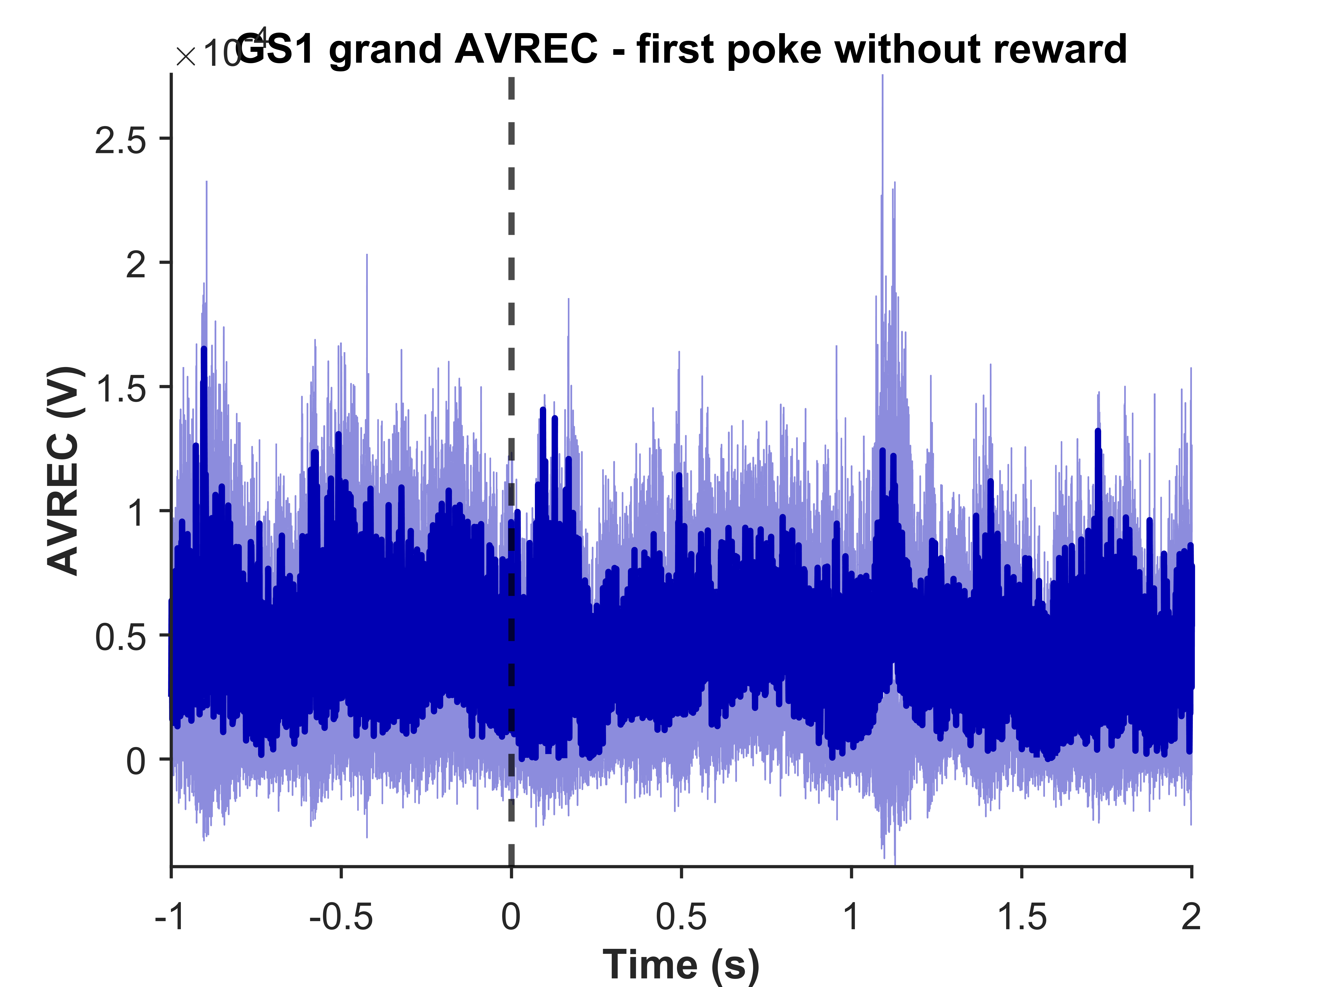
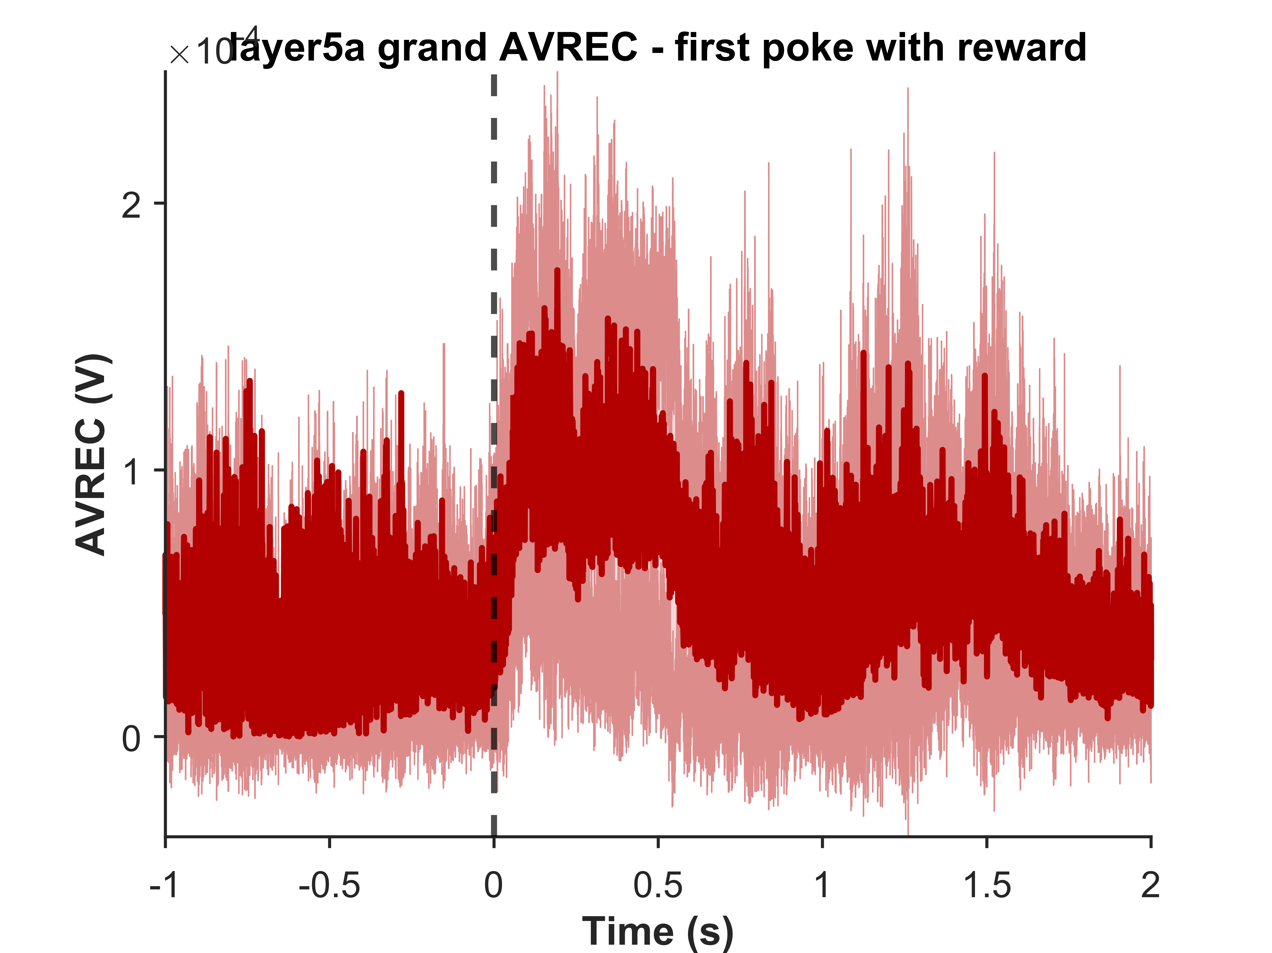
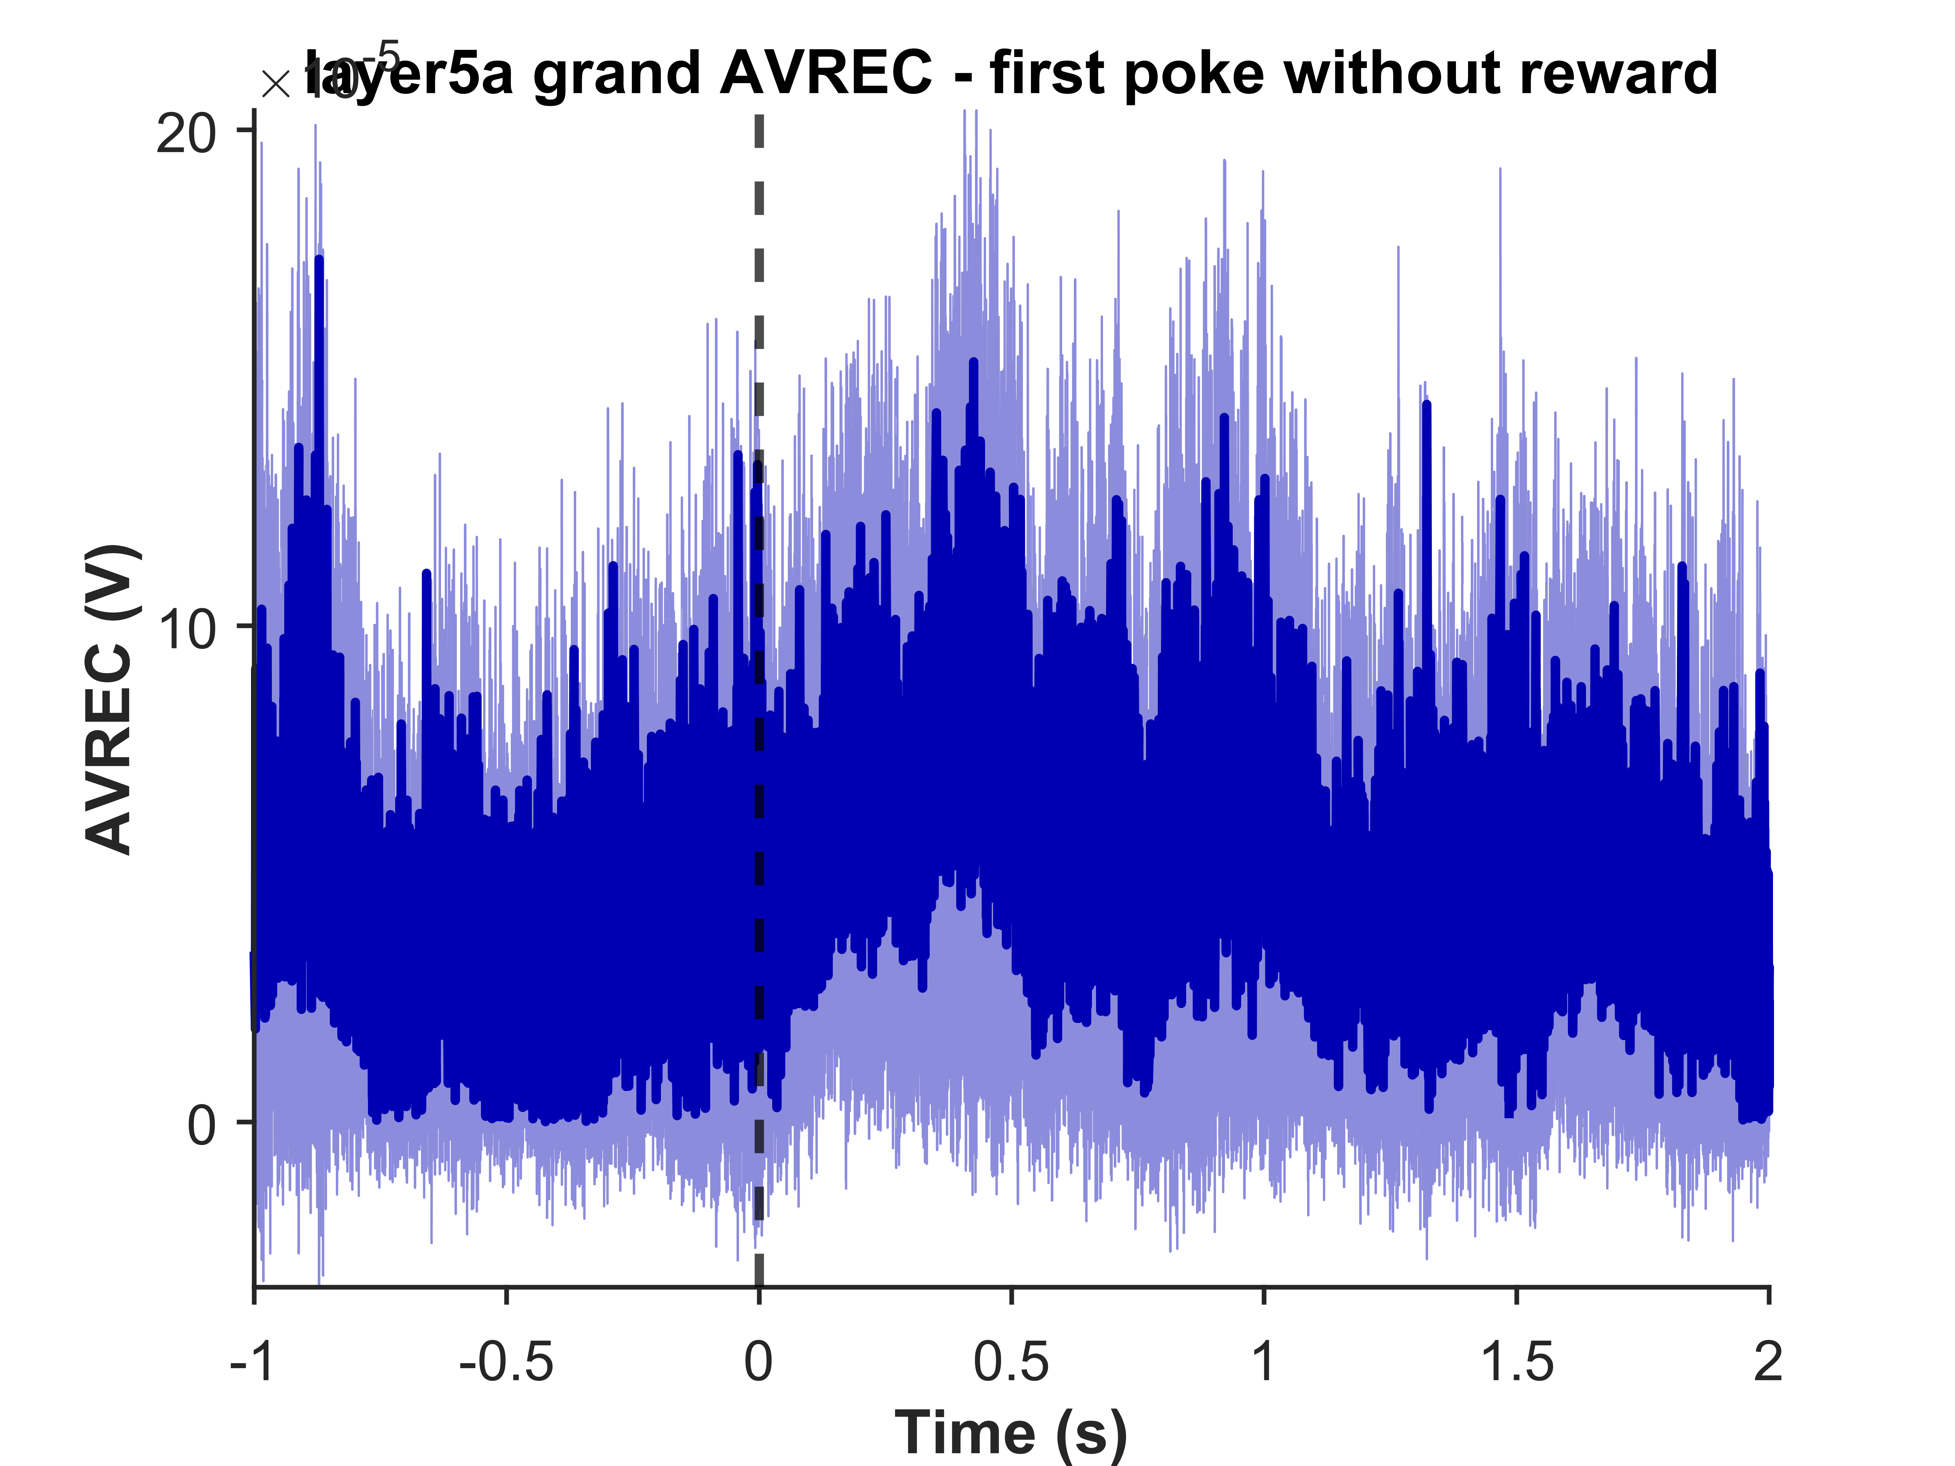
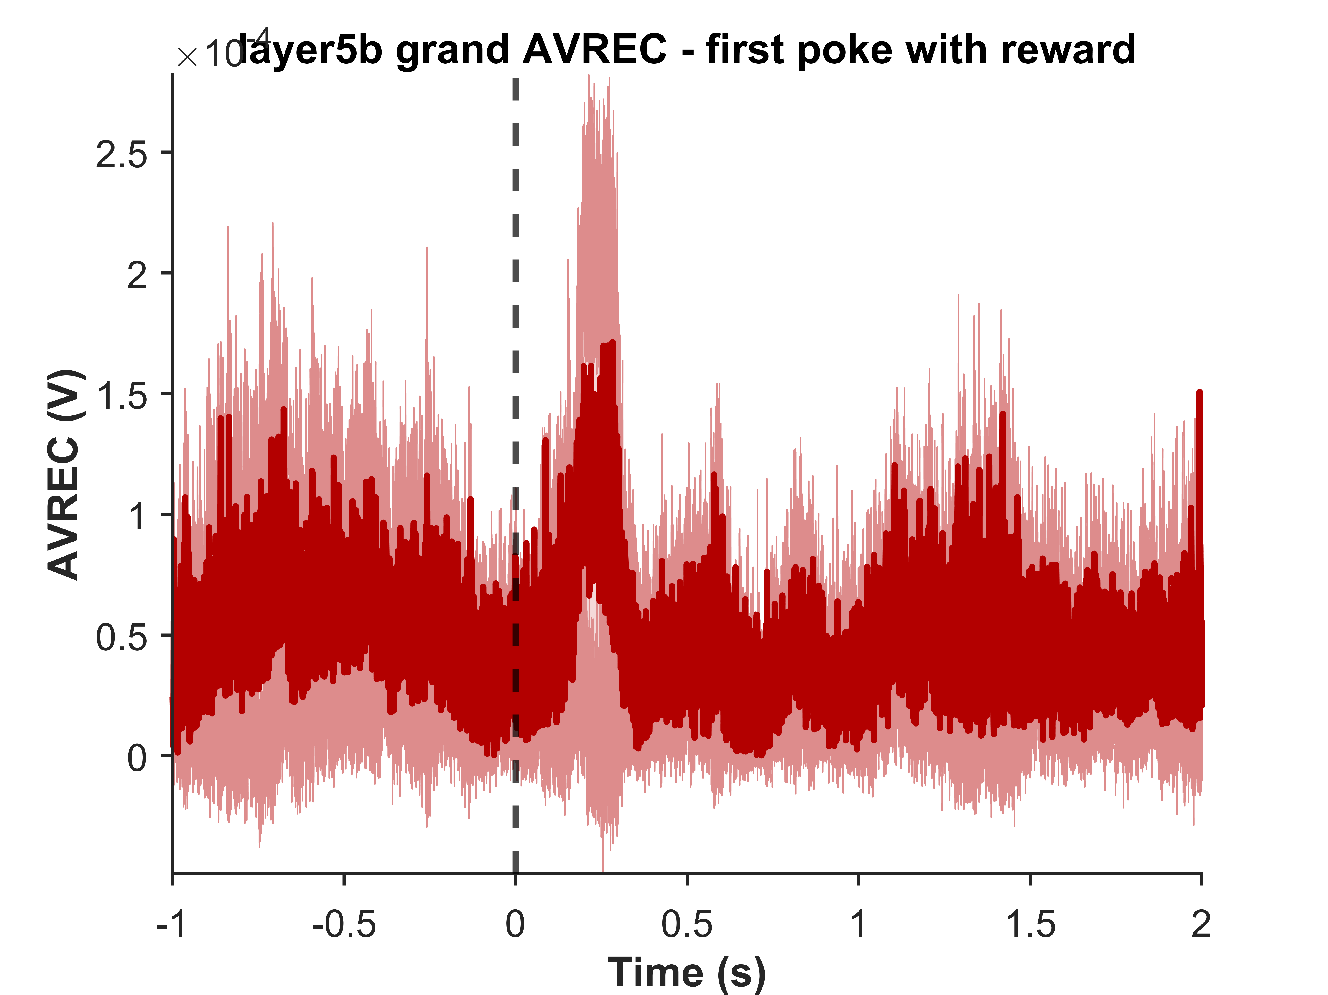
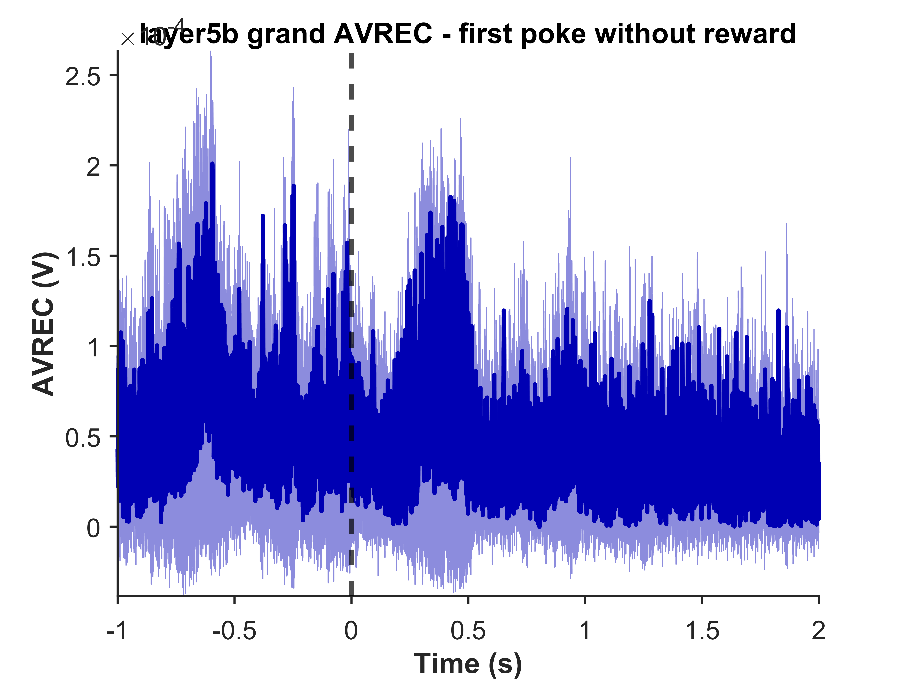
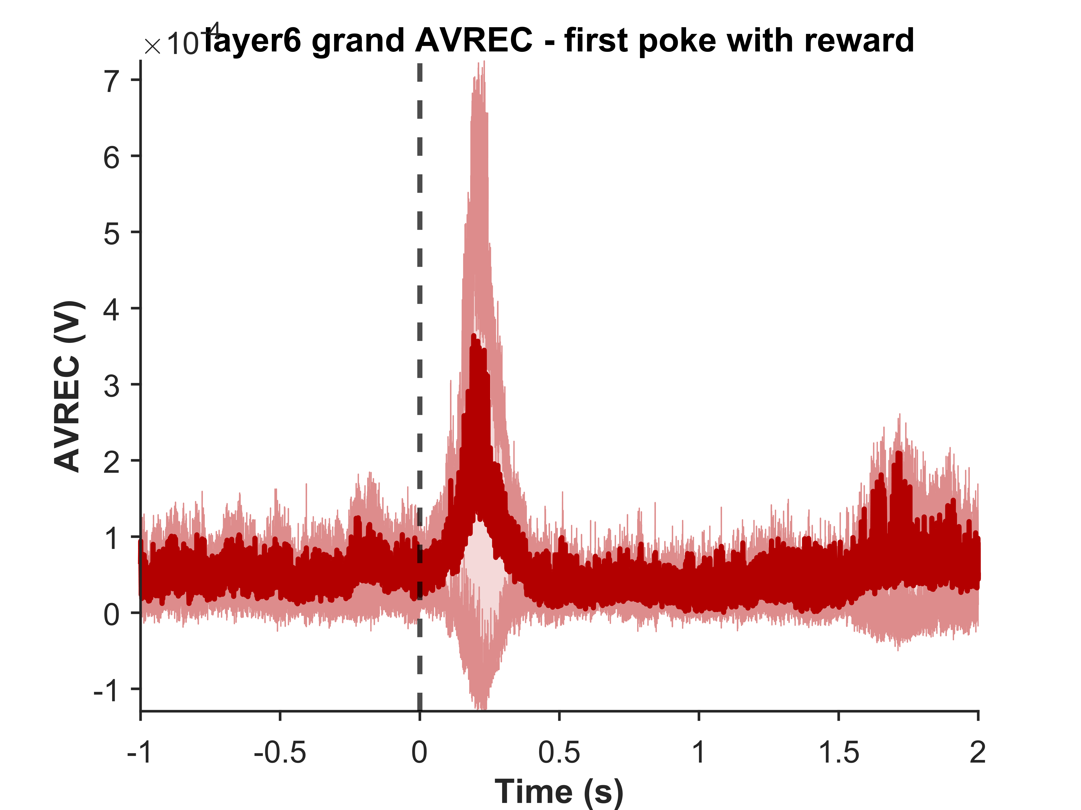
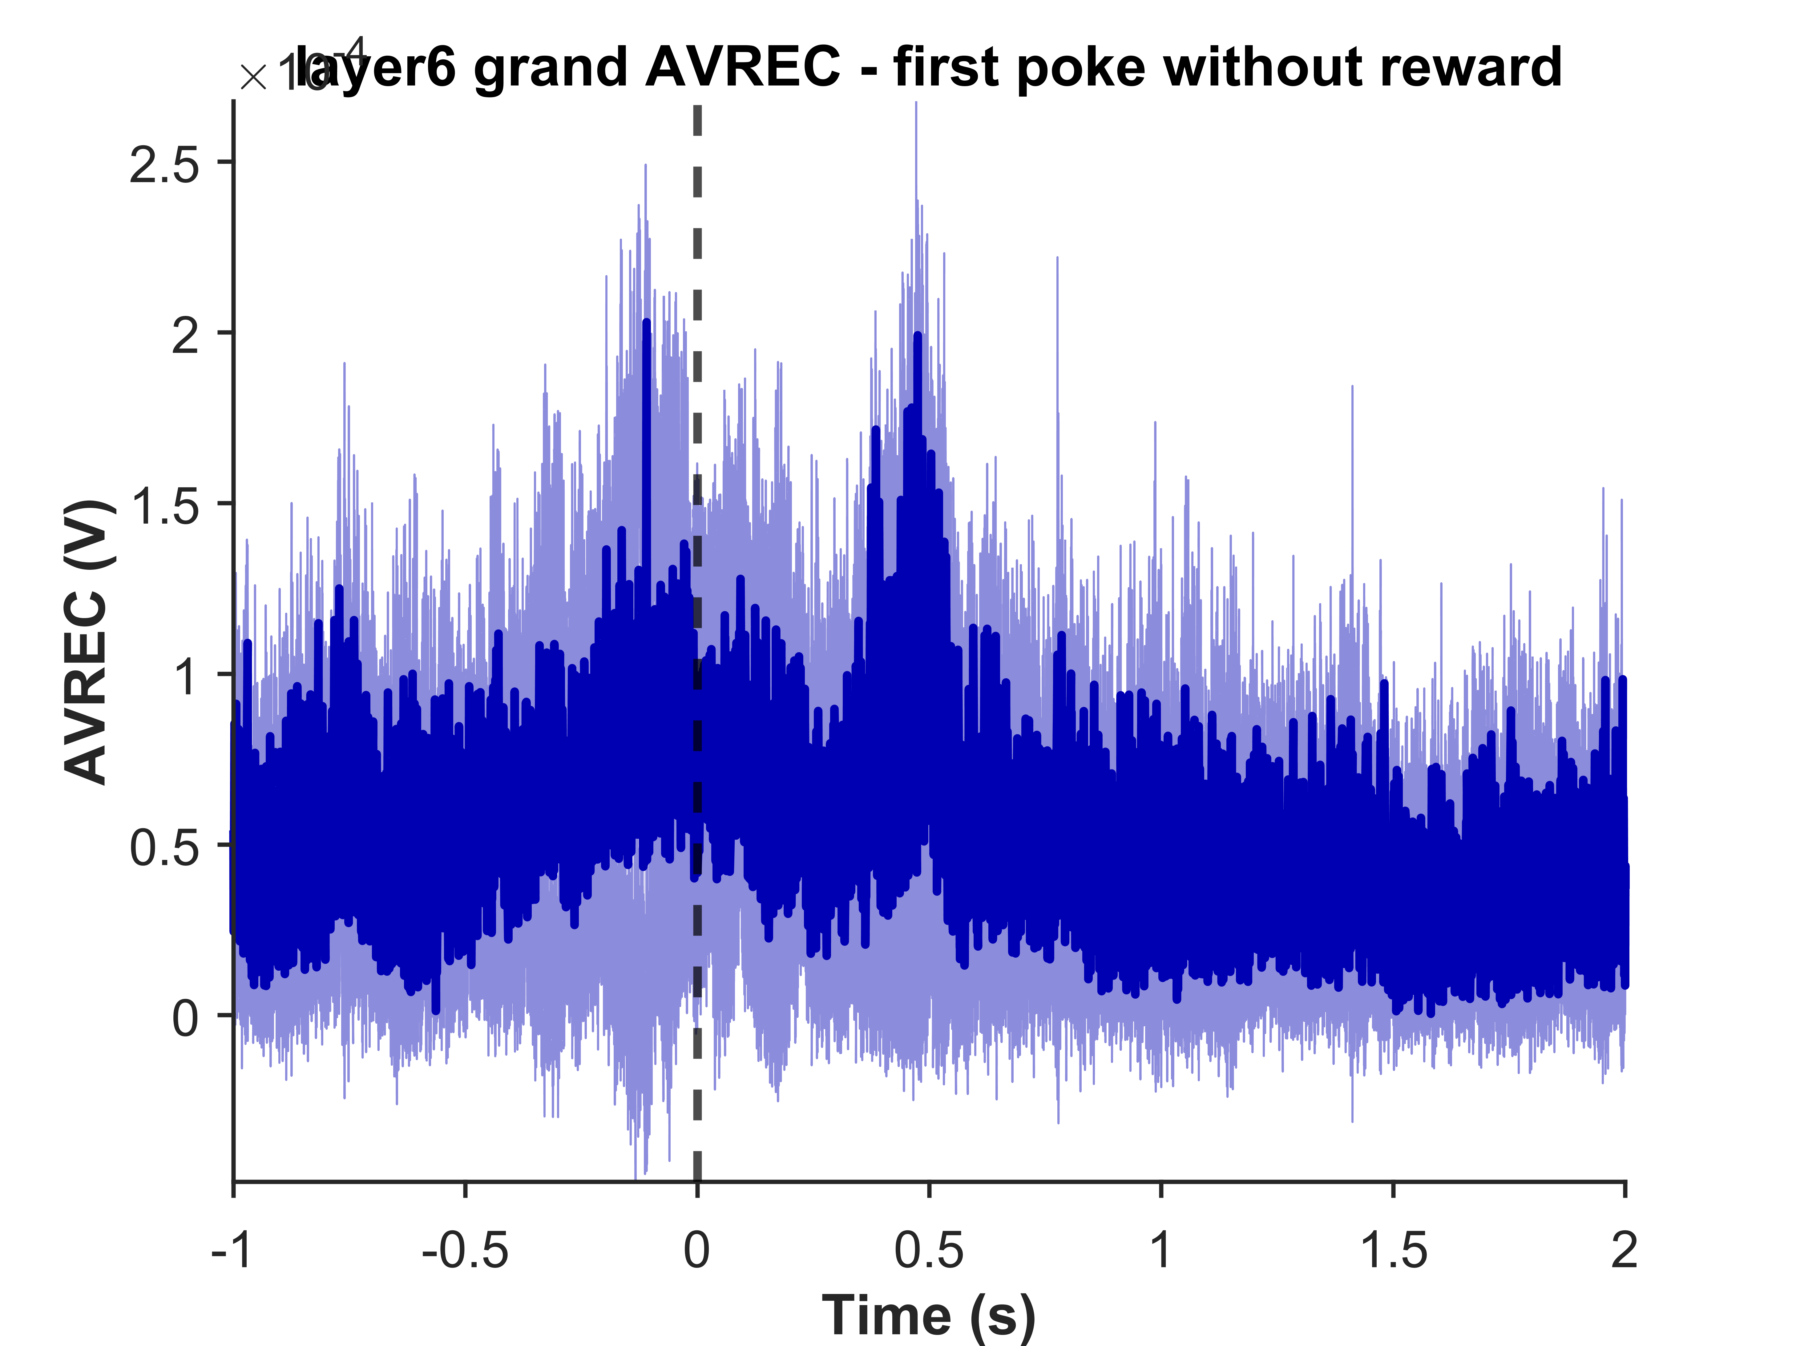
Grand layer wise average - Rectified sinks last reward to last poke
First poke with reward
First poke without reward
SGS1
GS1
Layer 5a
Layer 5b
Layer 6

Slide 17
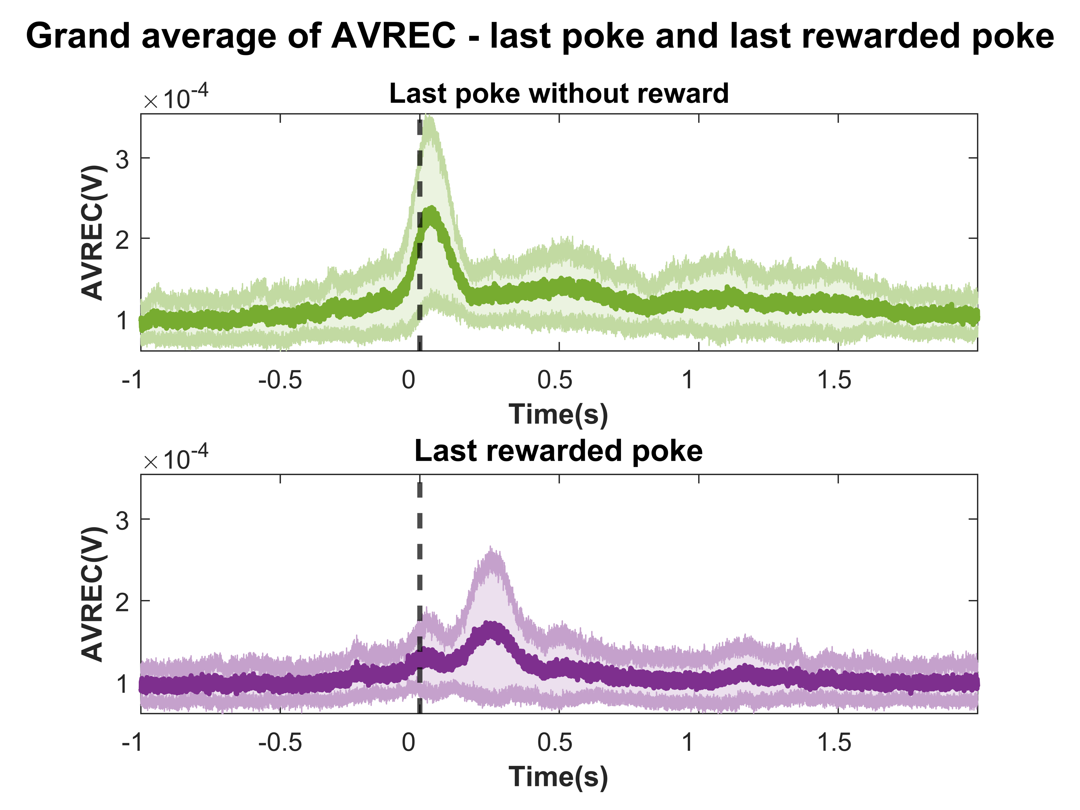
Grand AVREC Sessions 6 to 20
FOR008-12

Slide 18
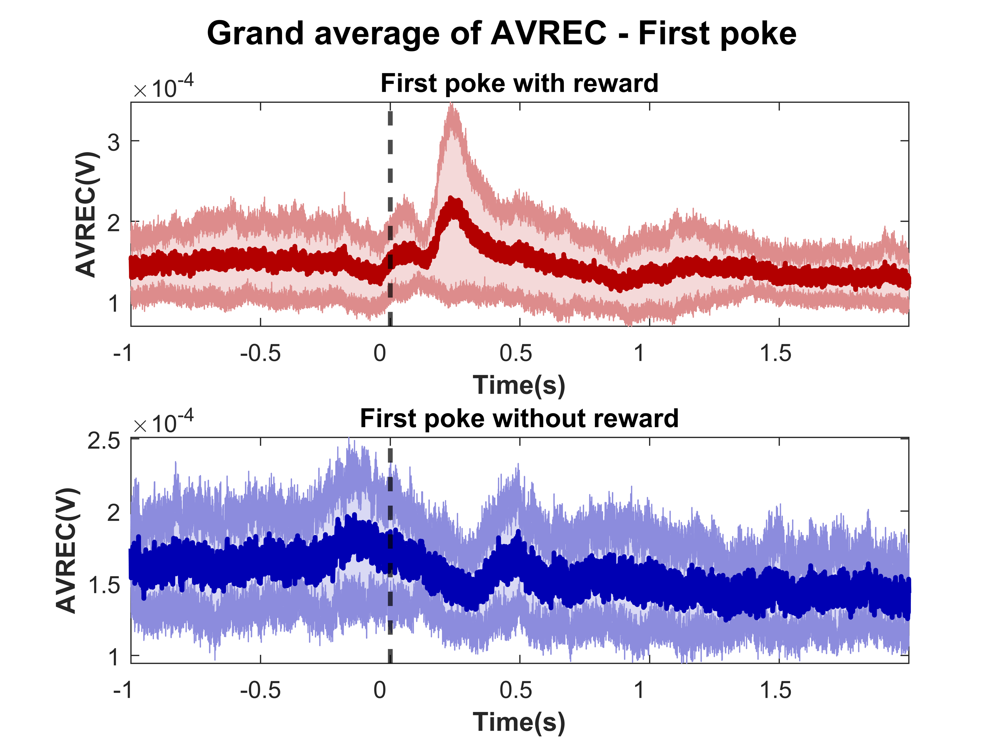
Grand AVREC Sessions 6 to 20
FOR008-12

Slide 19
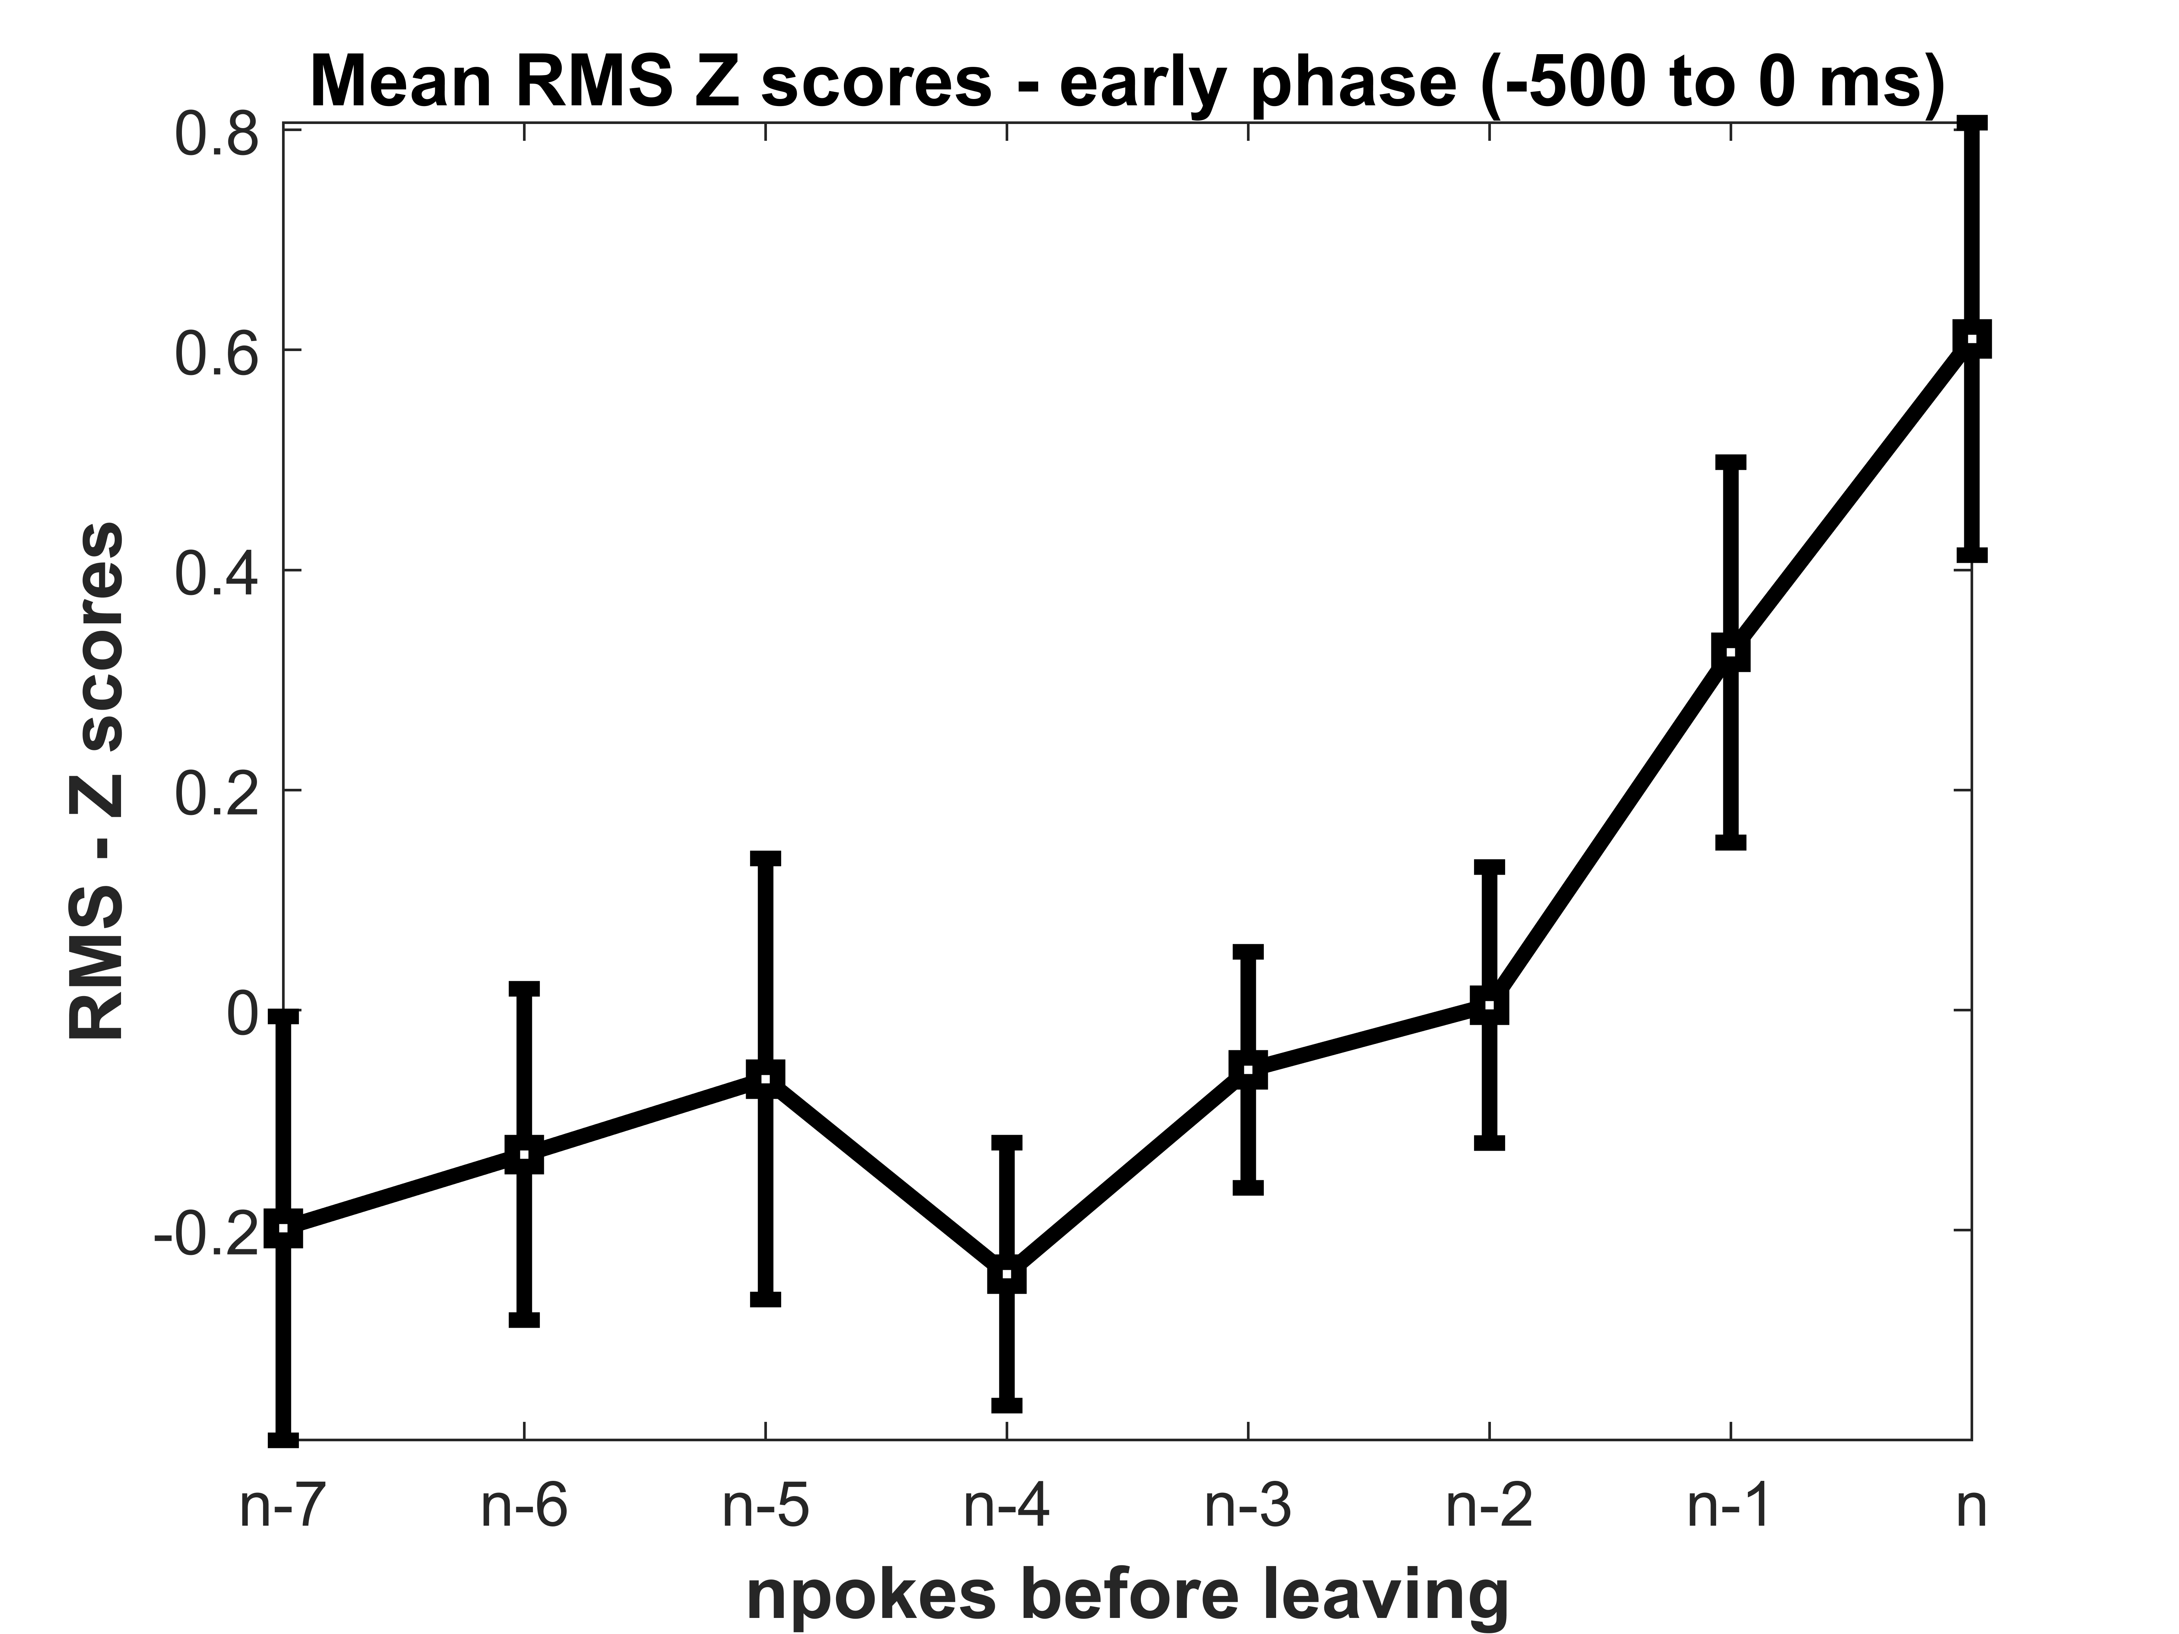
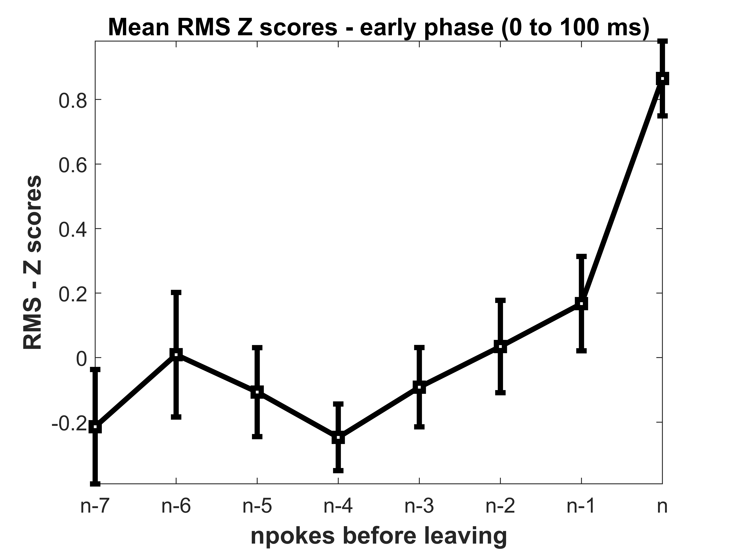
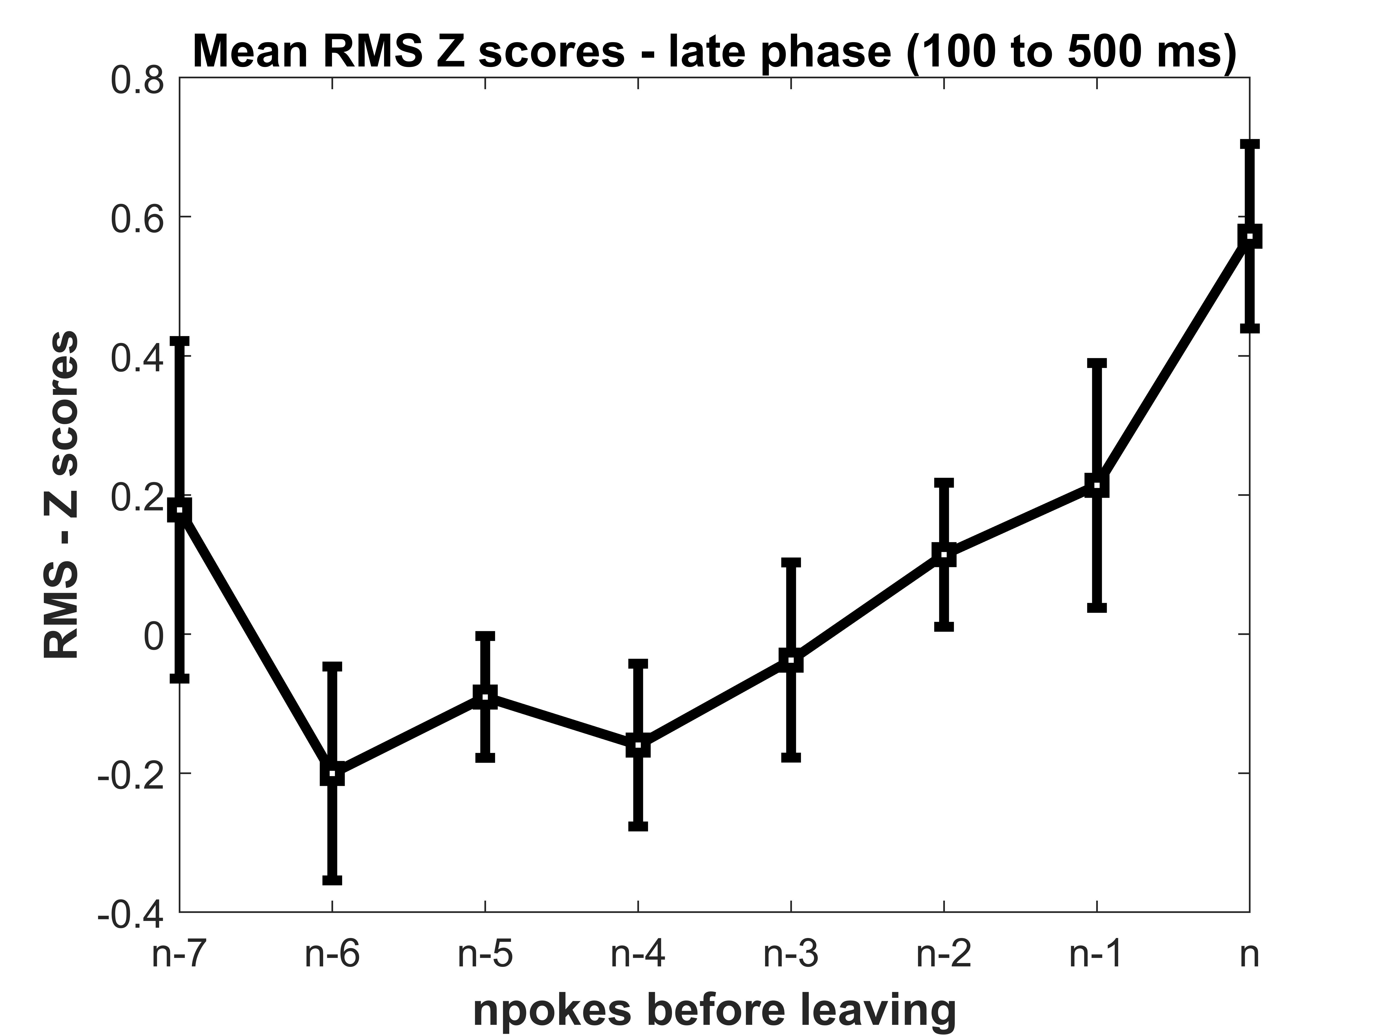
RMS ANALYSIS Last reward poke to last poke

Slide 20
RMS ANALYSIS First poke to last reward poke

Slide 21
Layer Analysis

Slide 22
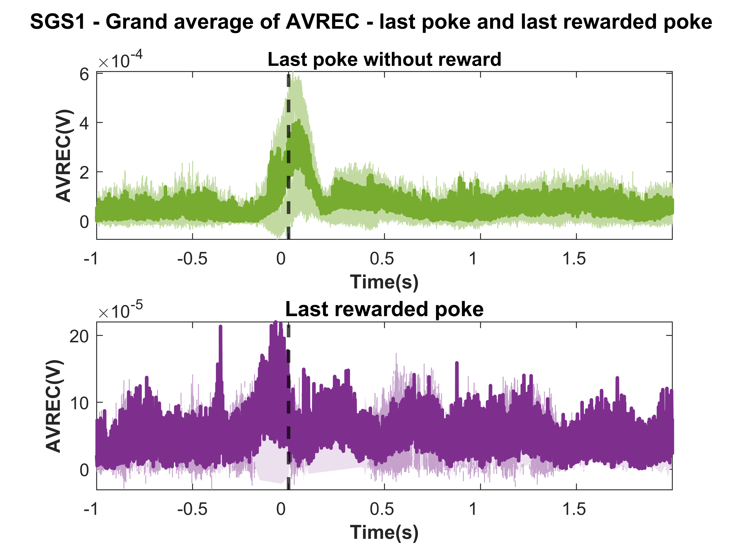
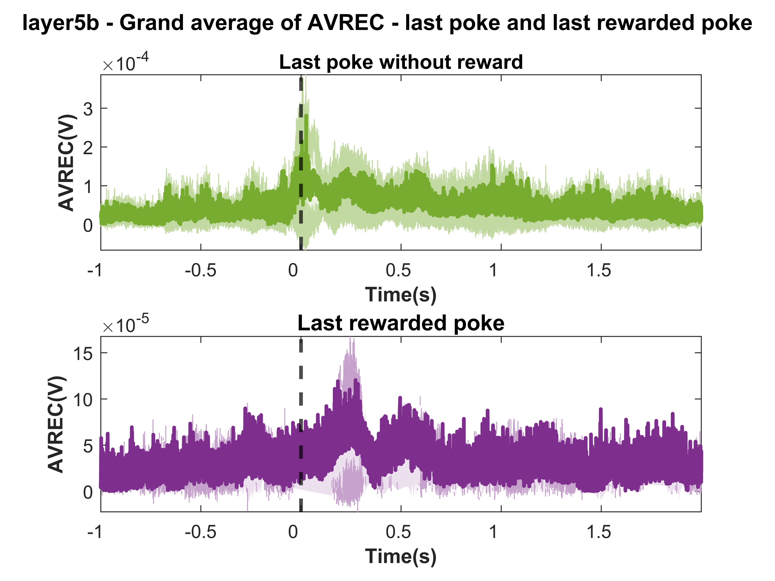
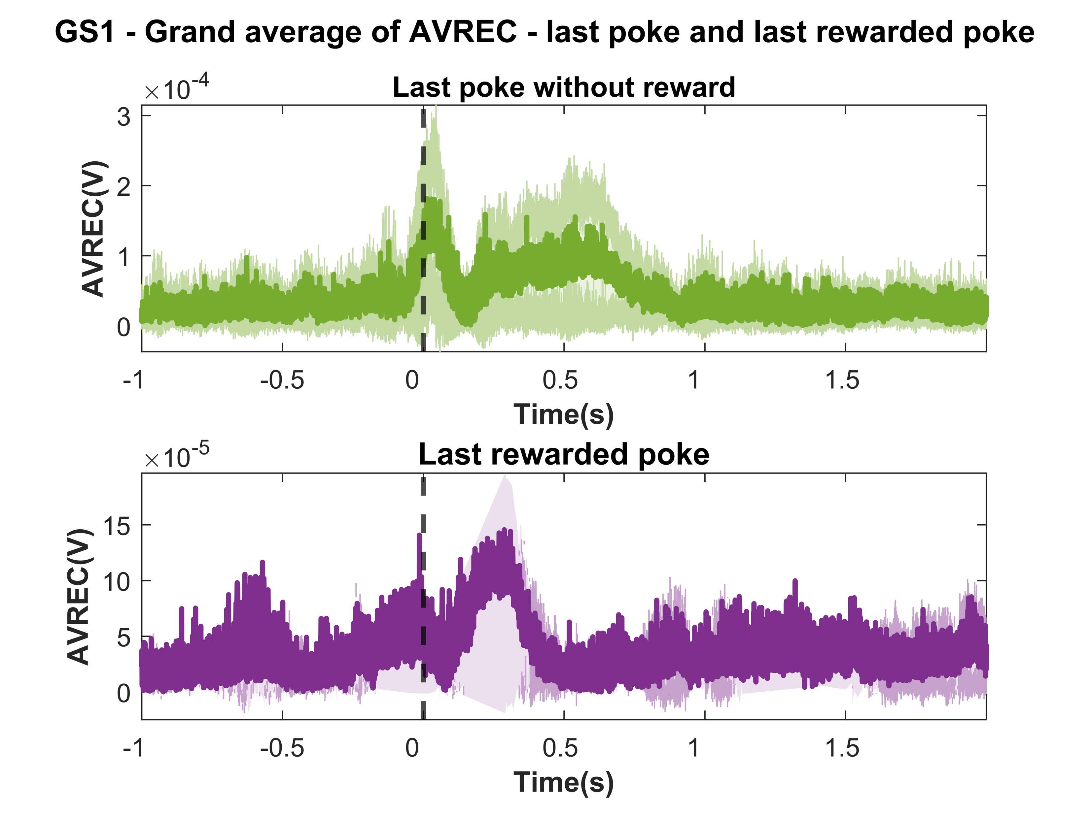
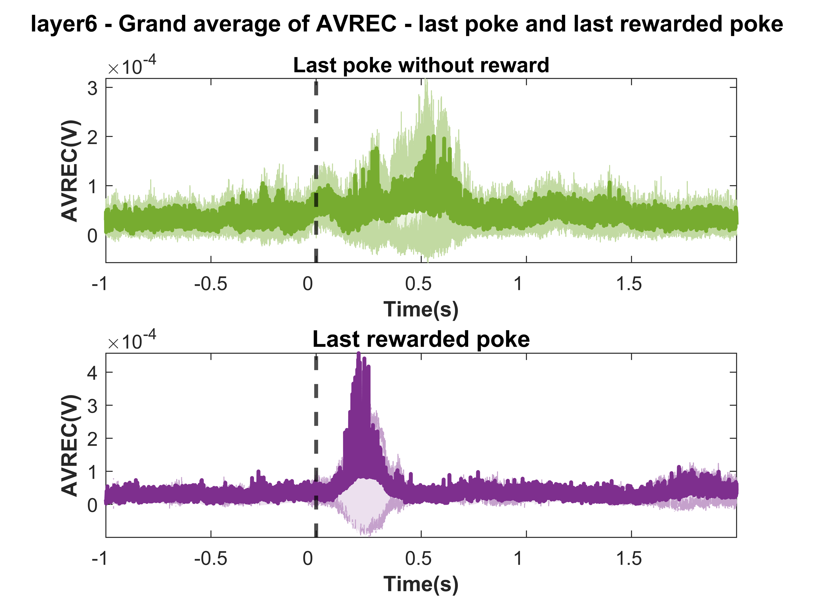
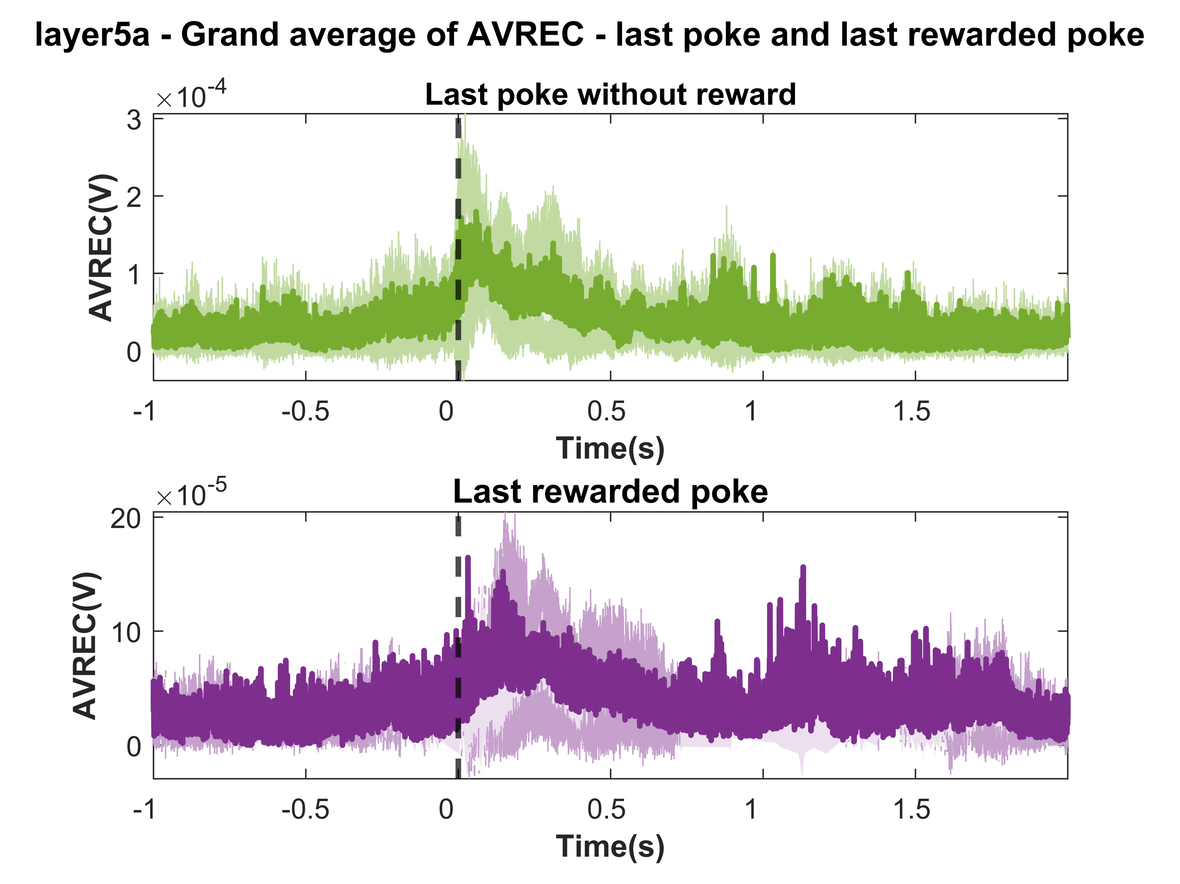
Grand AVREC Sessions 6 to 20

Slide 23
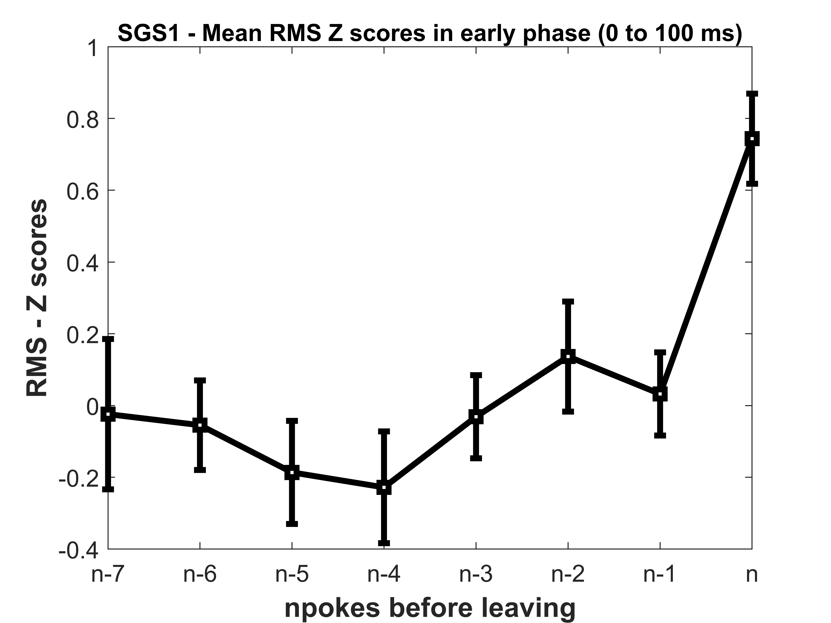
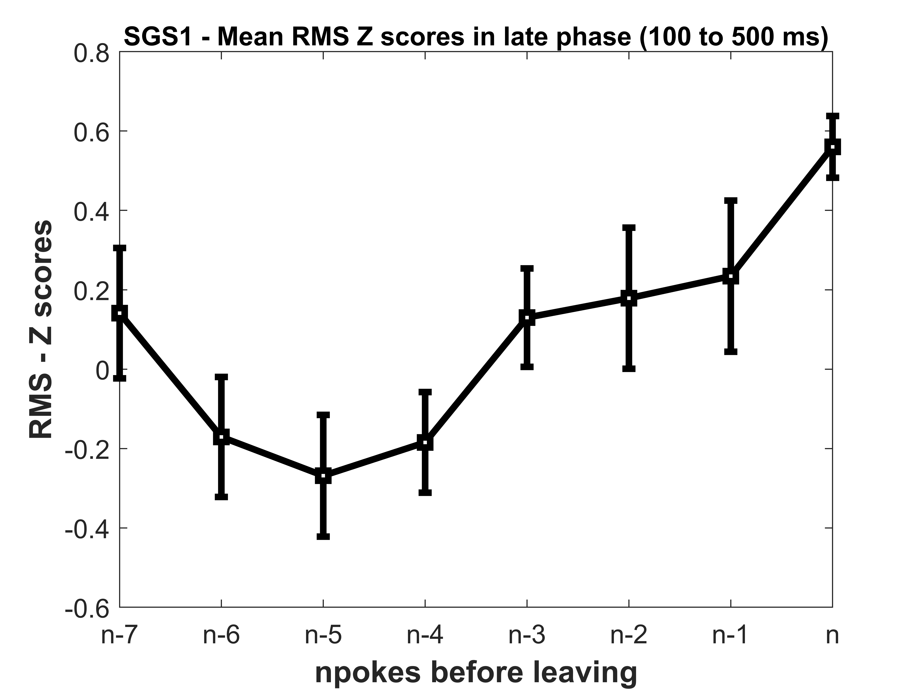
RMS ANALYSIS Last reward poke to last poke
SGS1

Slide 24
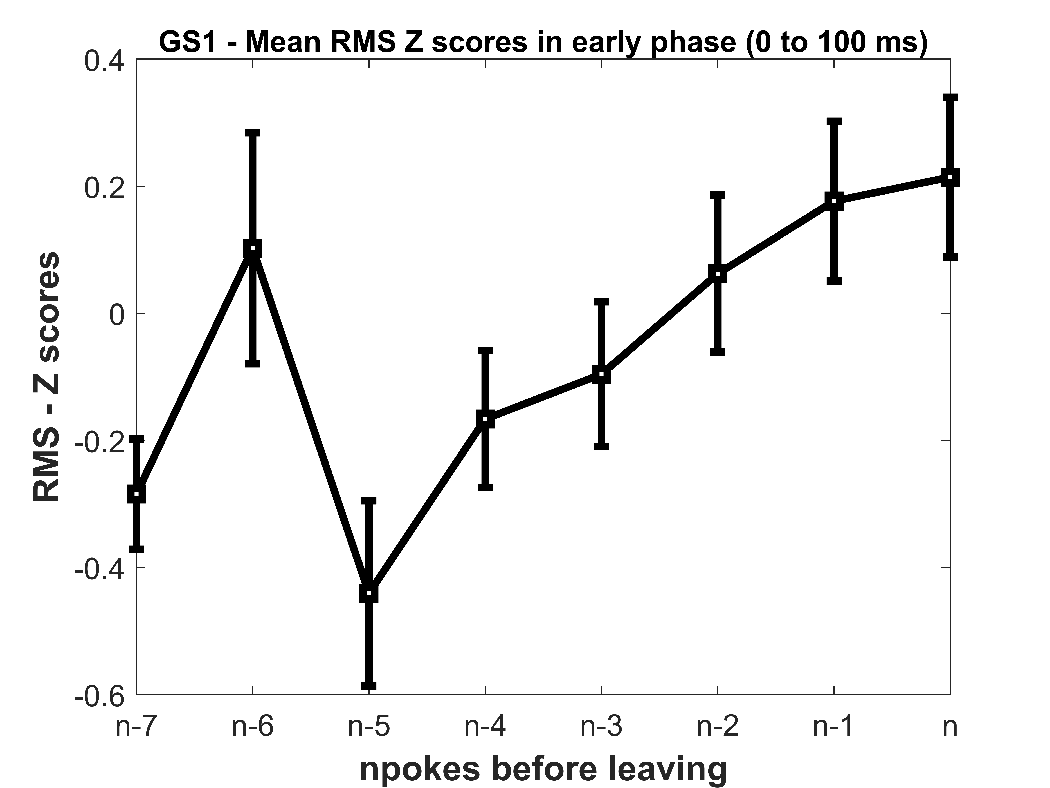
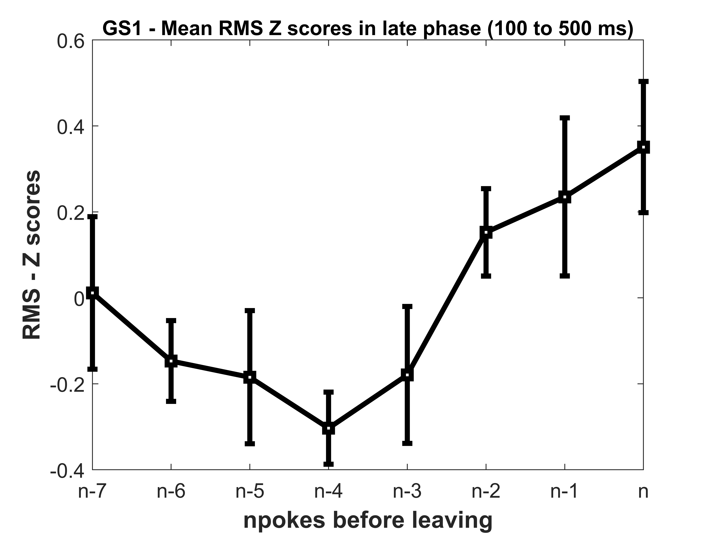
RMS ANALYSIS Last reward poke to last poke
GS1

Slide 25
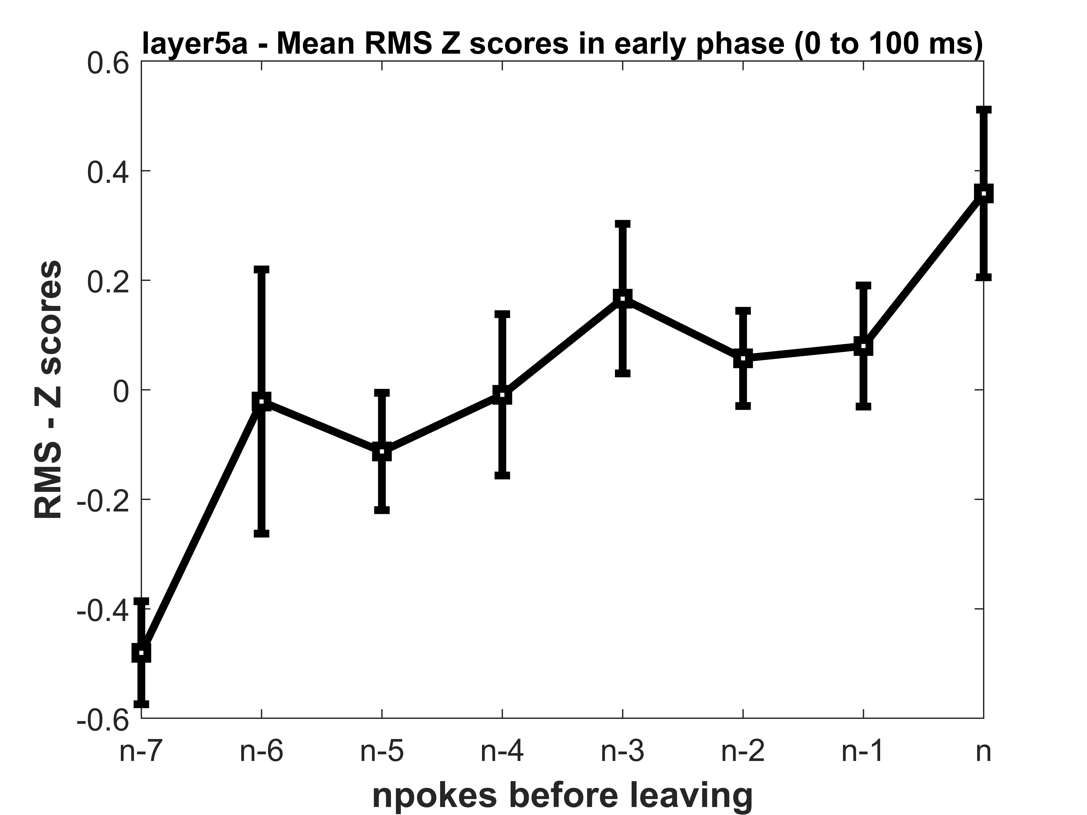
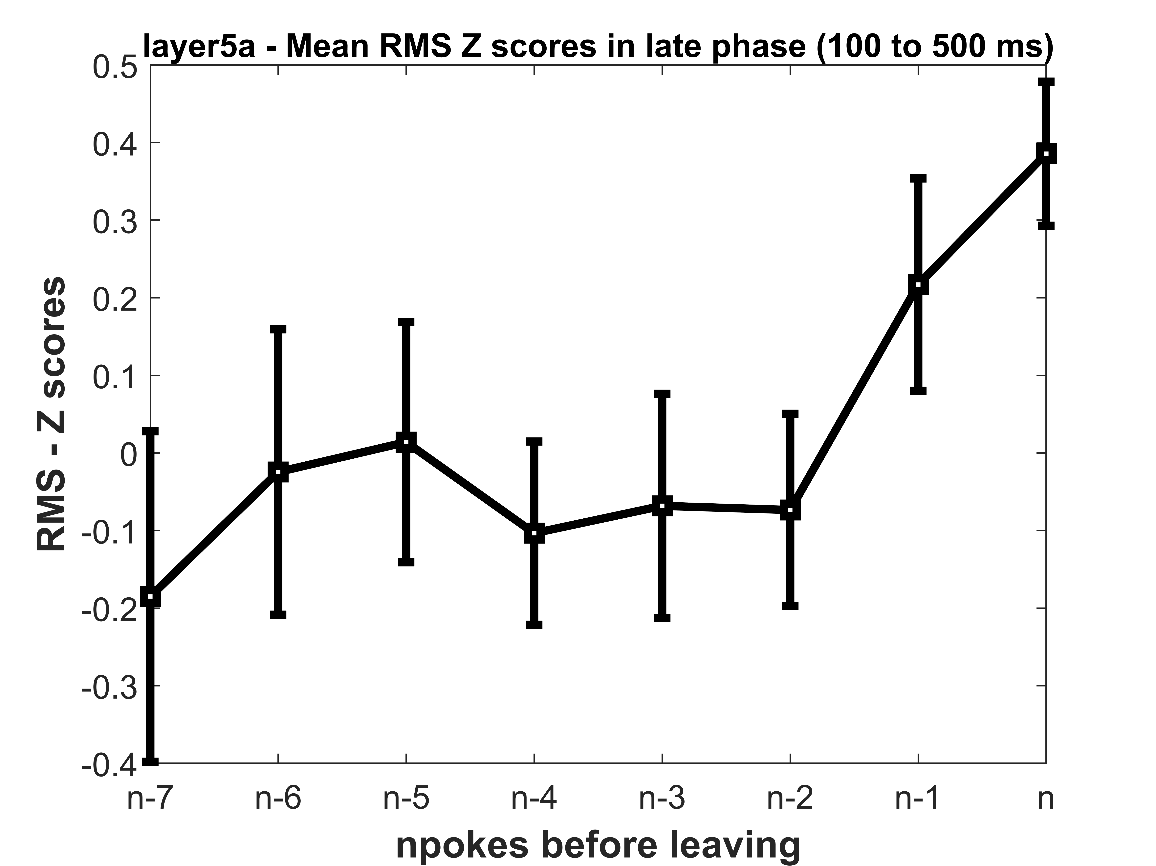
RMS ANALYSIS Last reward poke to last poke
Layer 5a

Slide 26
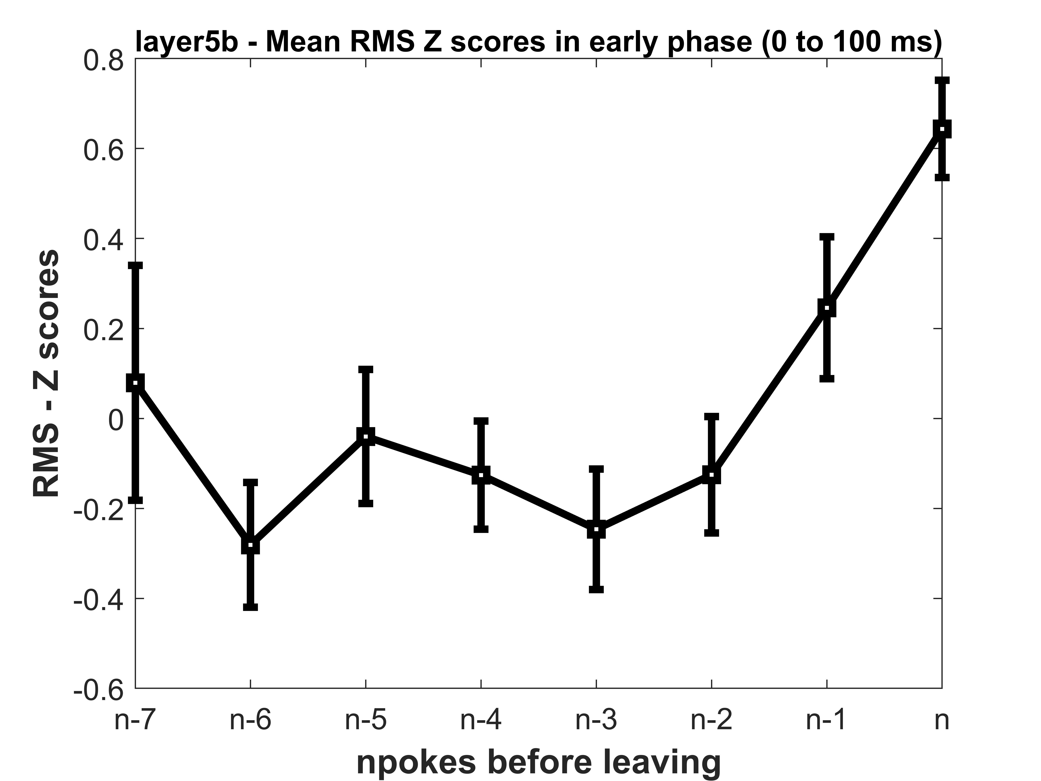
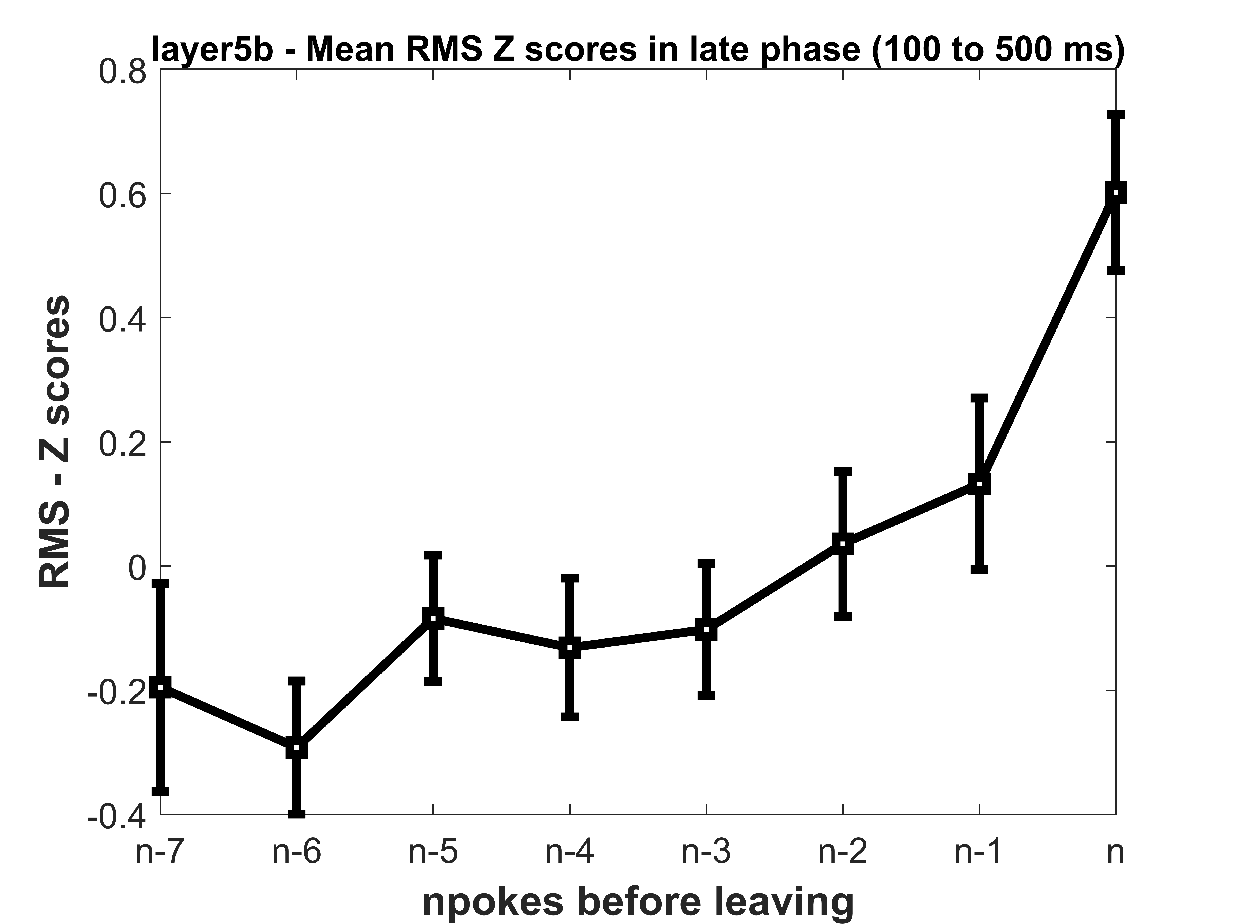
RMS ANALYSIS Last reward poke to last poke
Layer 5b

Slide 27
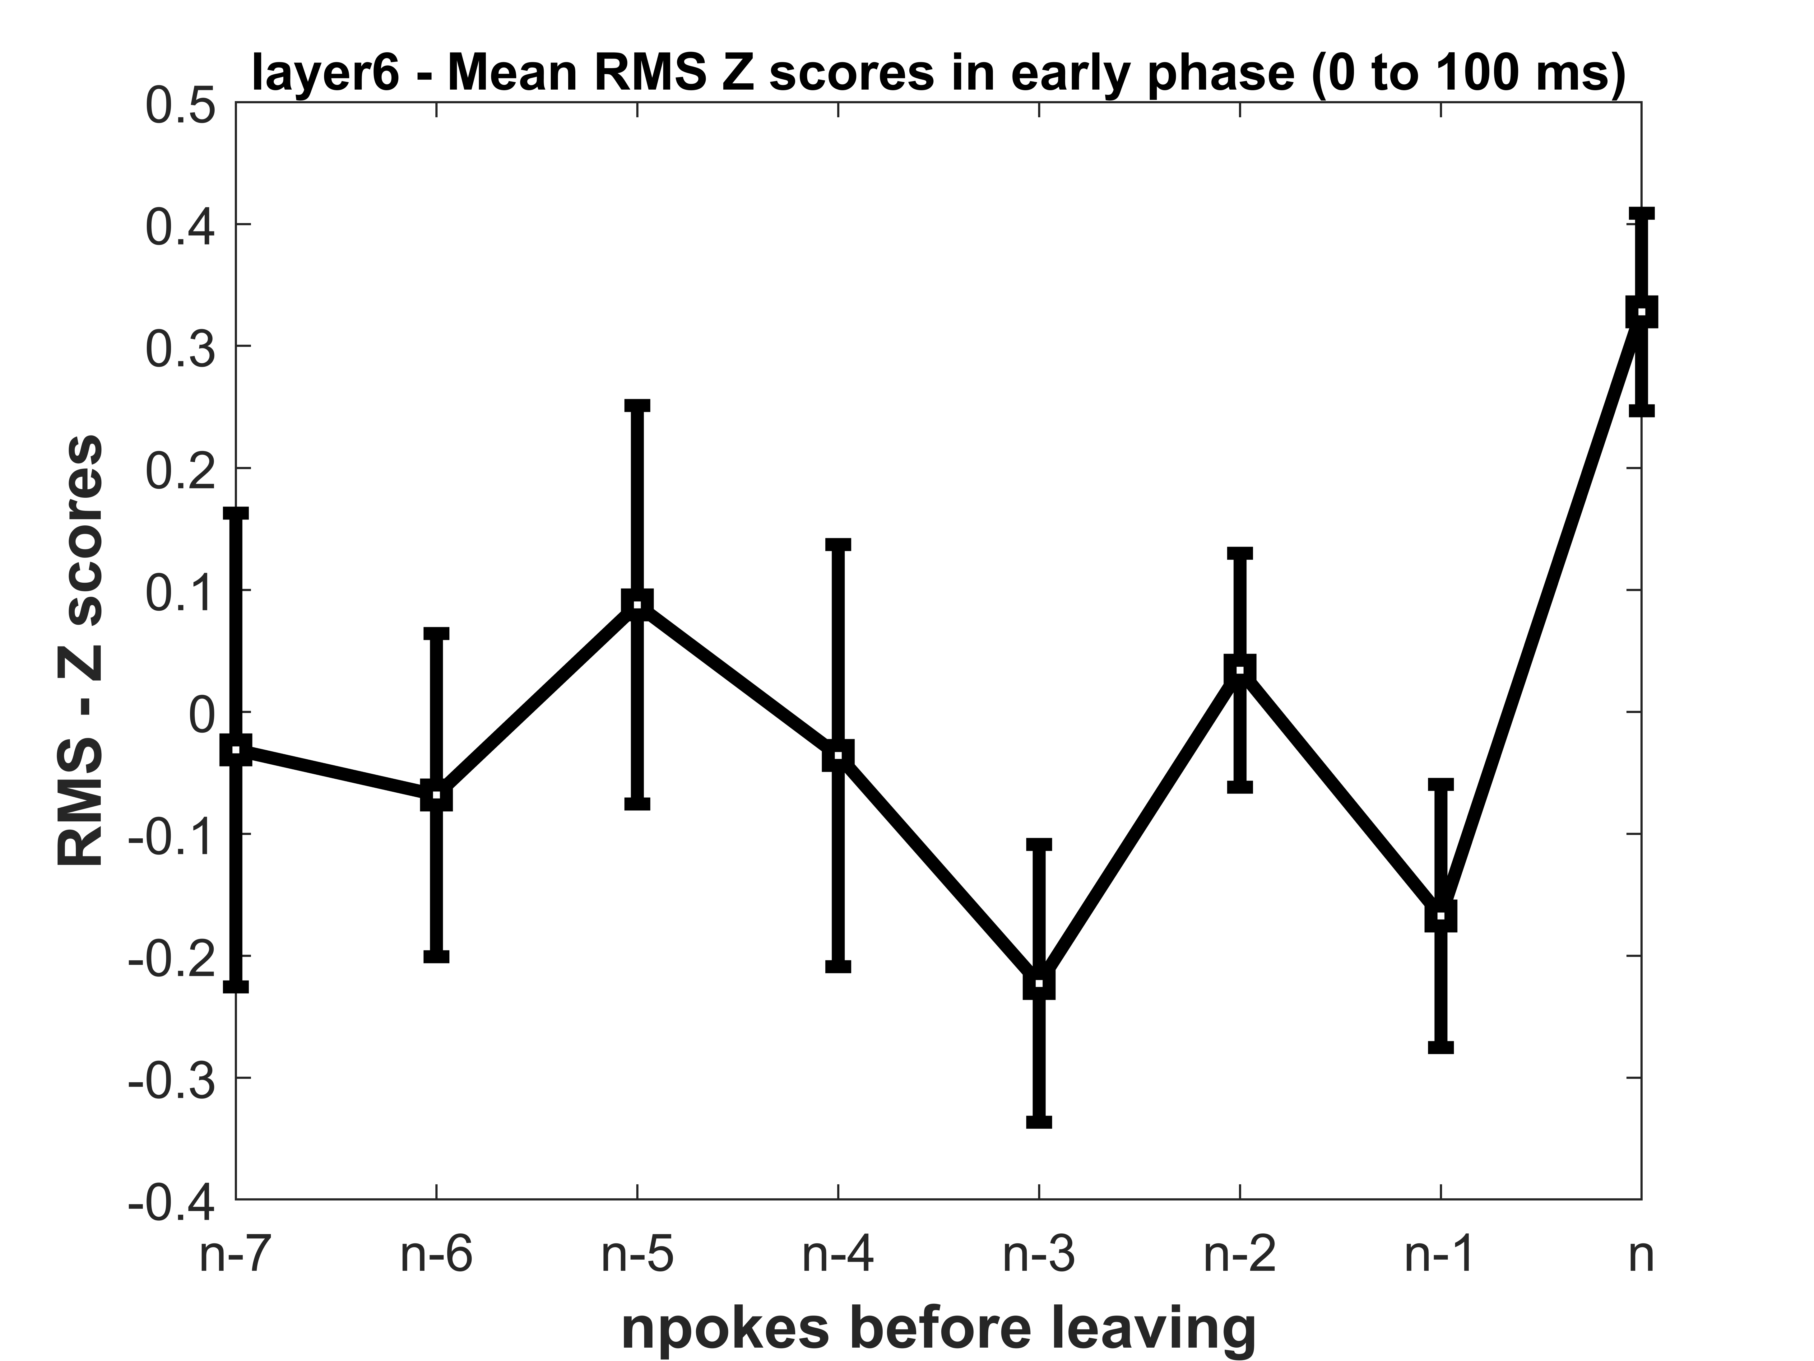
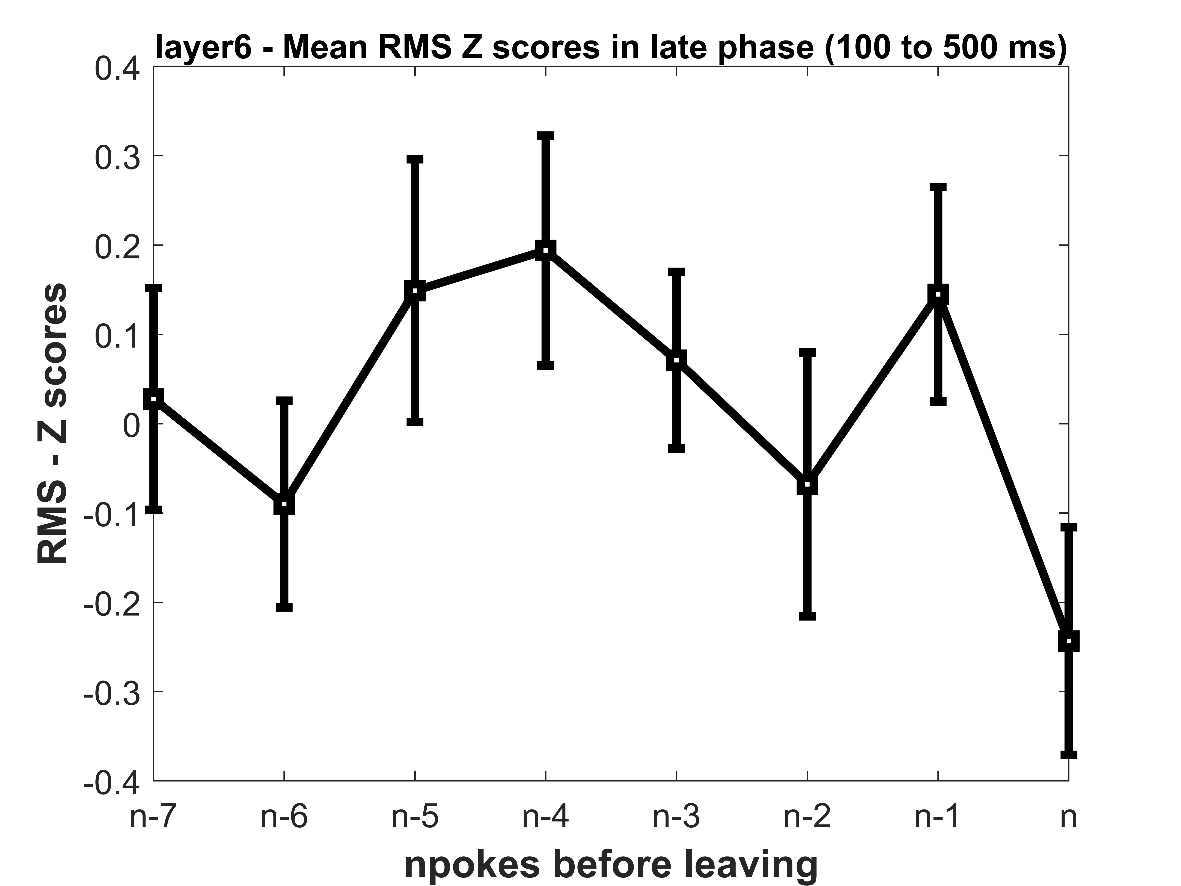
RMS ANALYSIS Last reward poke to last poke
Layer 6

